Slide 1
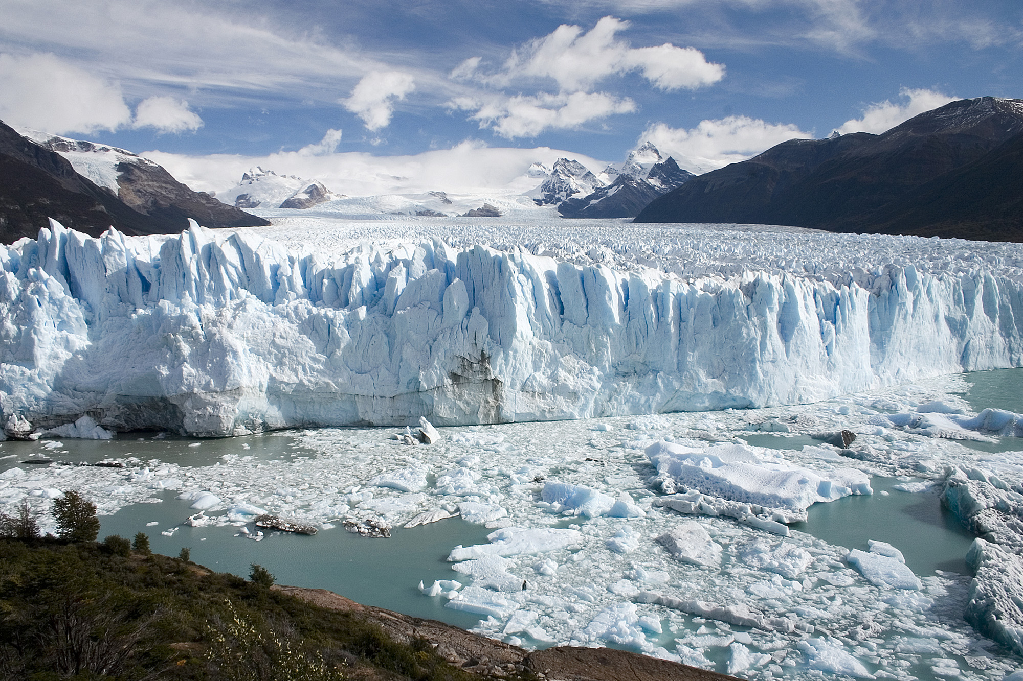
Come see the glaciers before they melt!

Slide 2
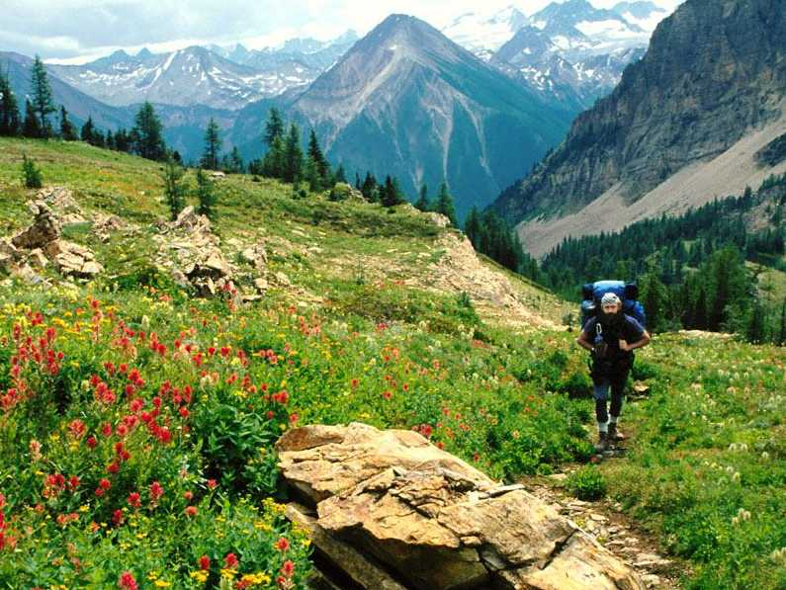
What do I have to do to get your attention? Put an ad in the paper? God

Slide 3
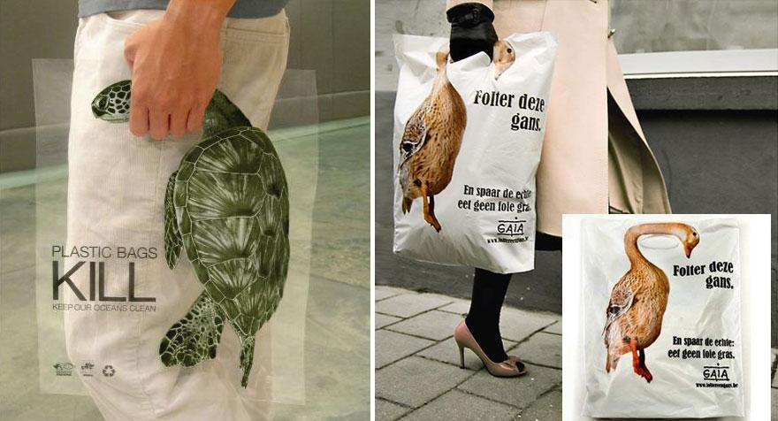

Slide 4
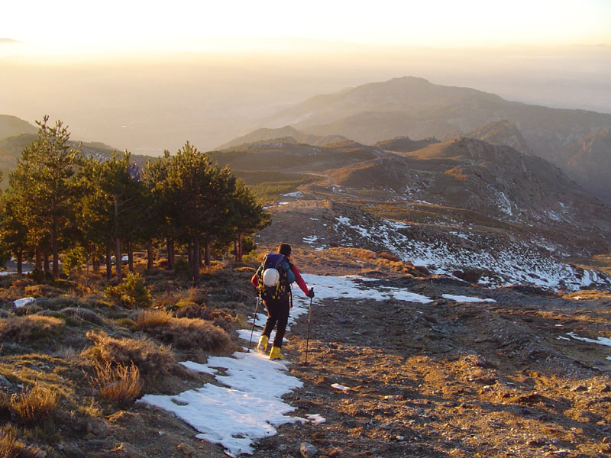
Earth people, do not treat me like a Martian. God

Slide 5
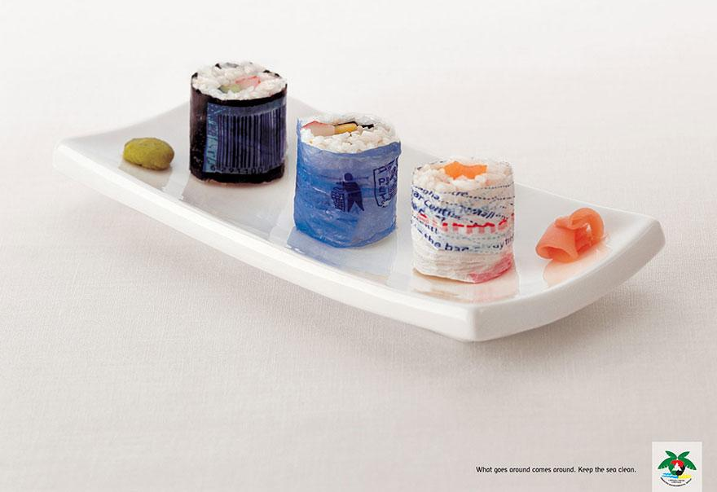

Slide 6
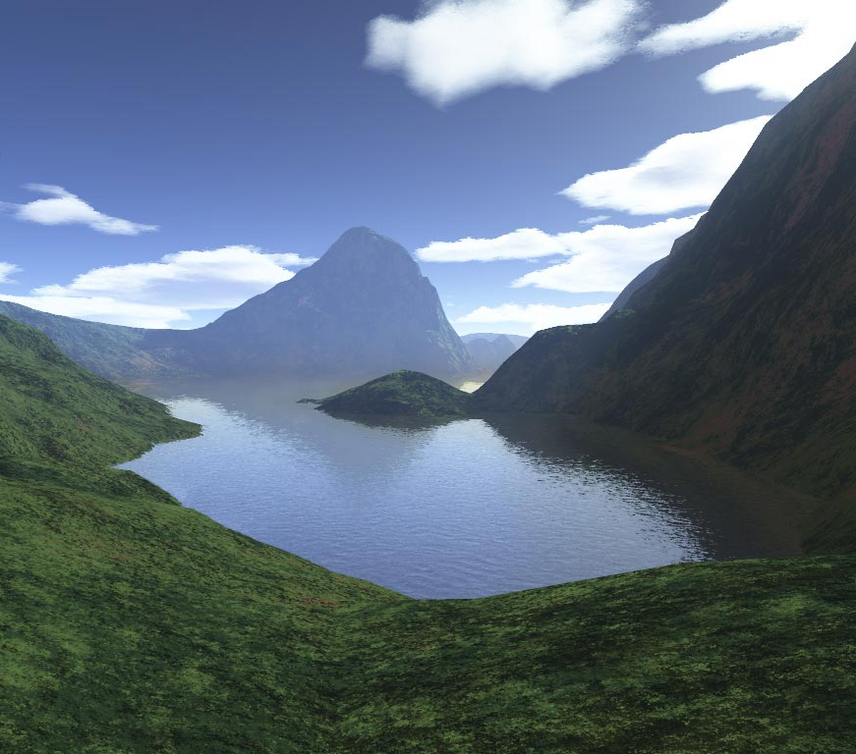
I thought about making the world black and white. But then I said ... naaah! God

Slide 7
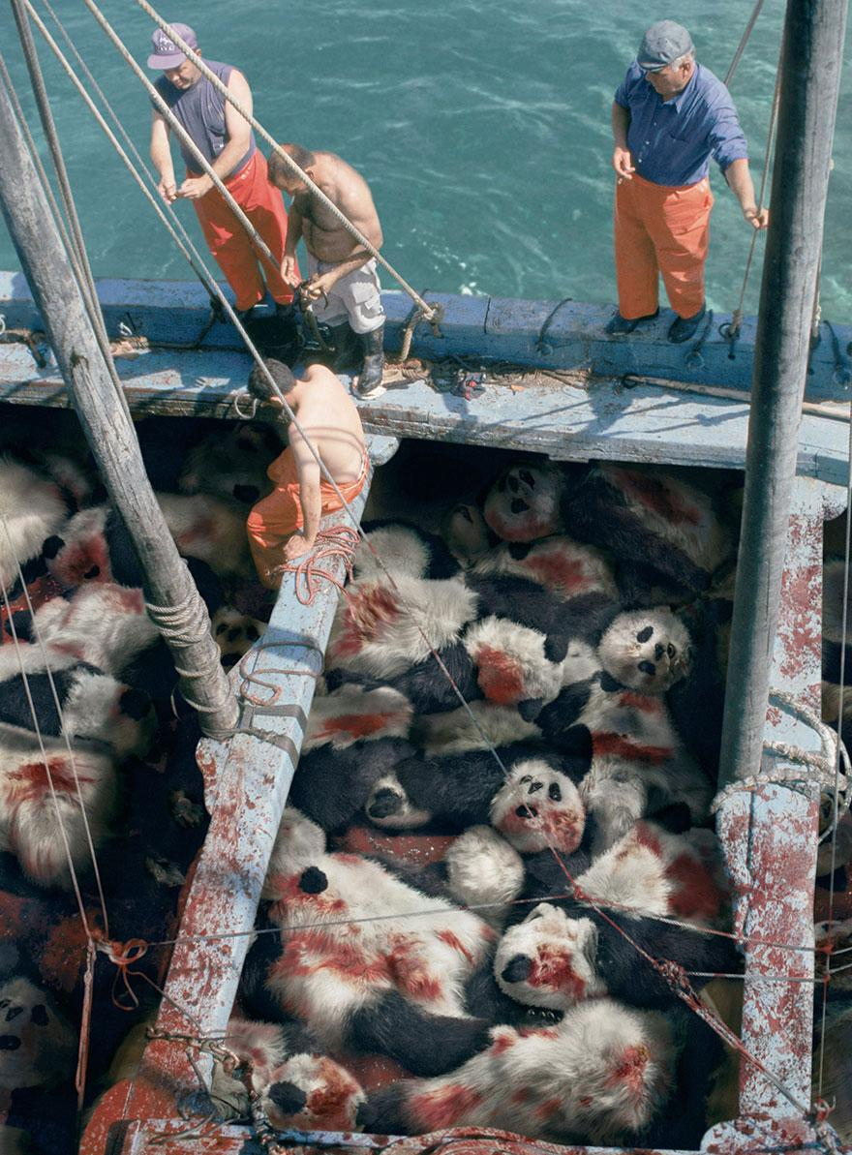

Slide 8
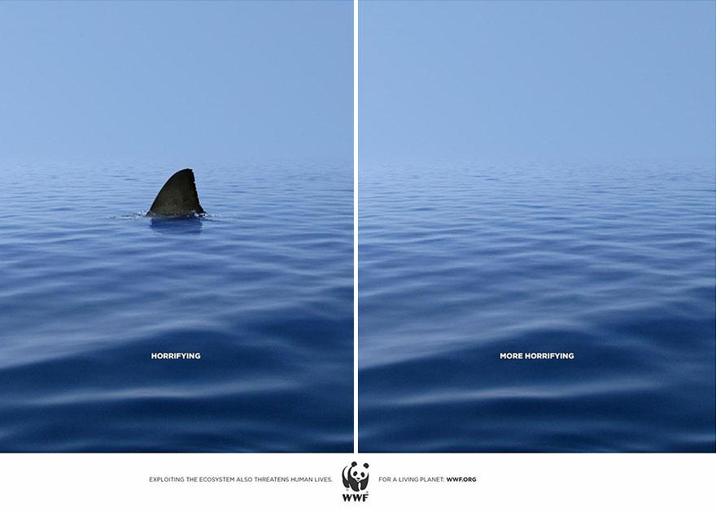

Slide 9
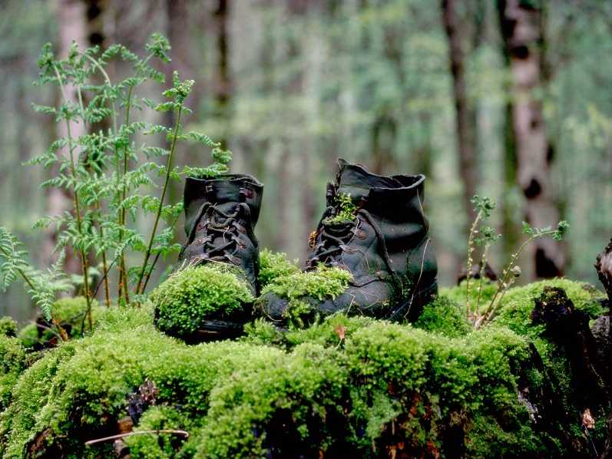
If you missed the dawn that I made for you today, it does not matter. I will make you another tomorrow. God

Slide 10
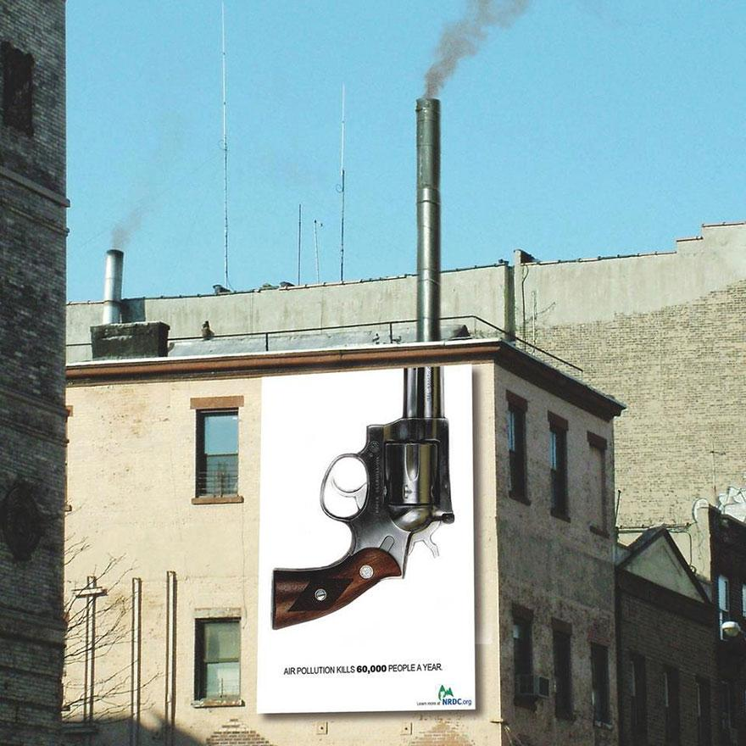

Slide 11
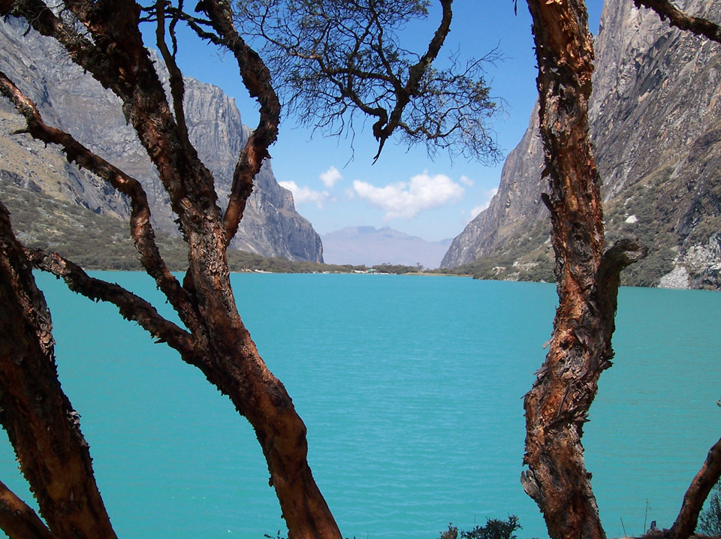
How can you be a self-made-man? I remember perfectly making you. God

Slide 12
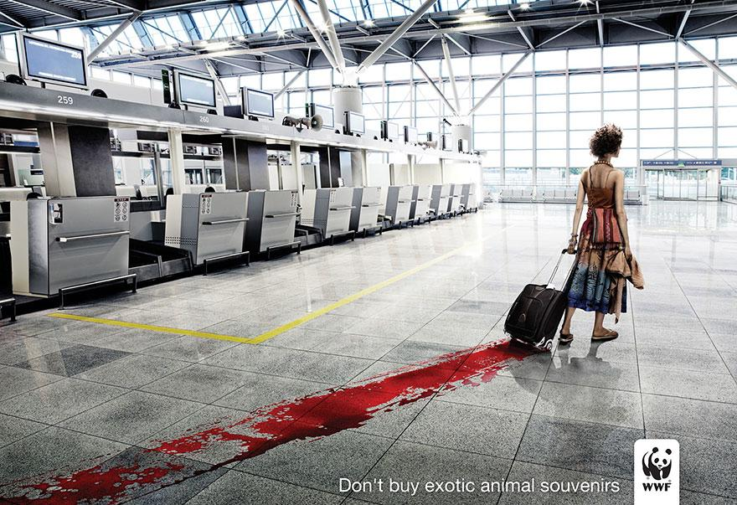

Slide 13
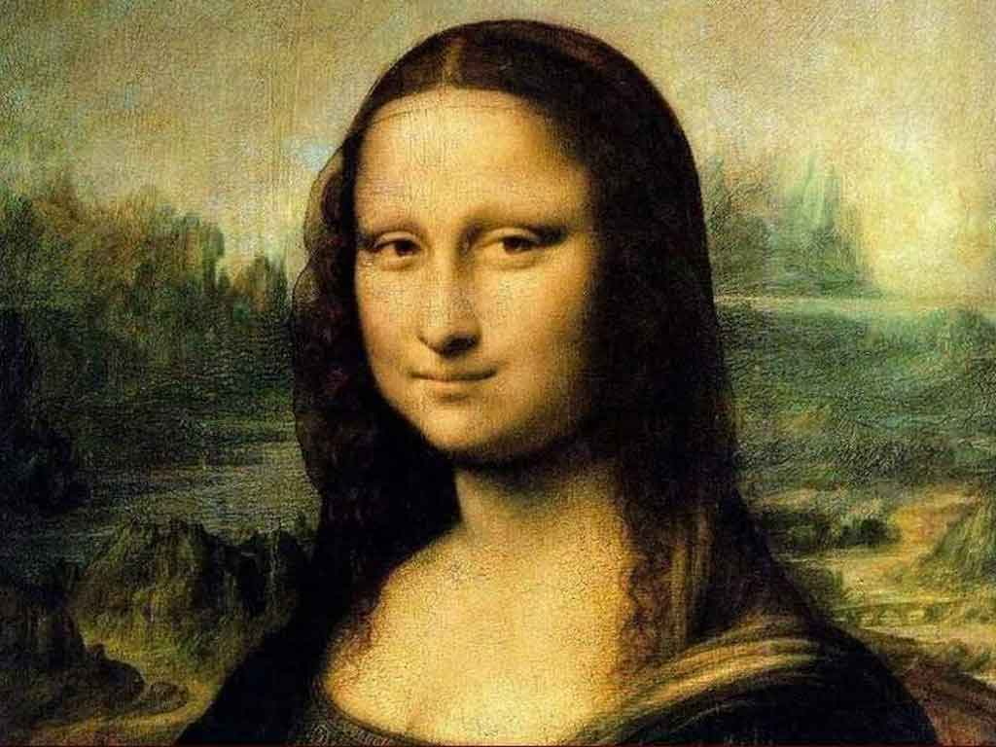
If you think Mona Lisa is amazing, you should see my master piece… in the mirror. God

Slide 14
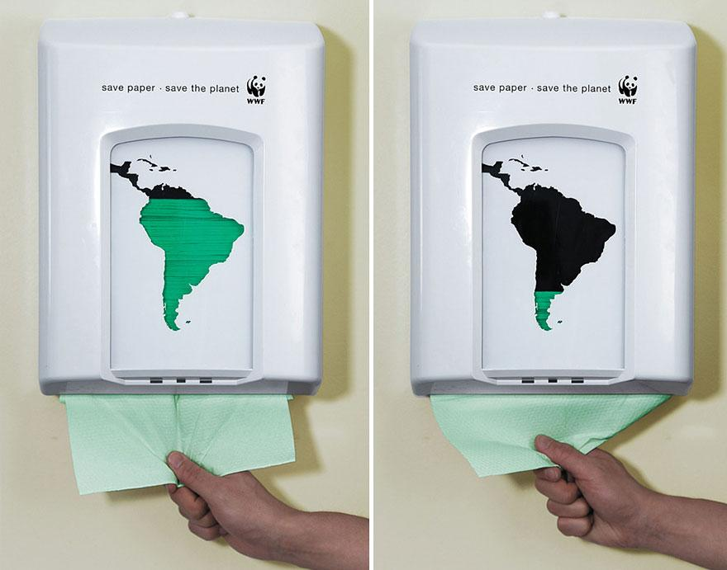

Slide 15
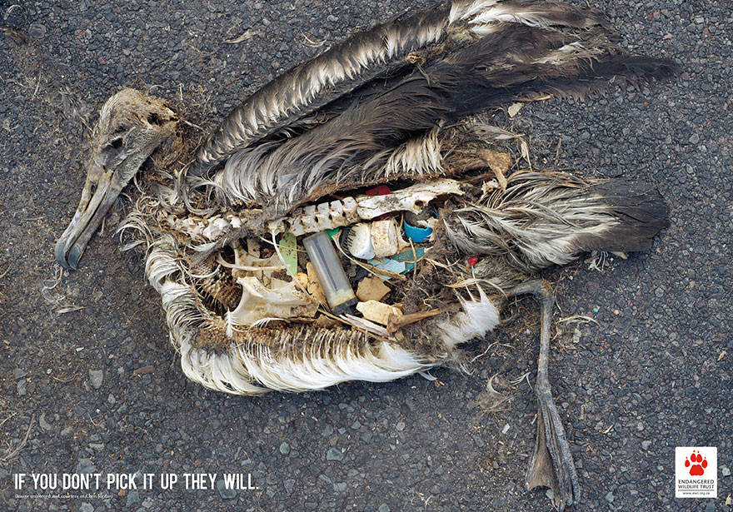

Slide 16
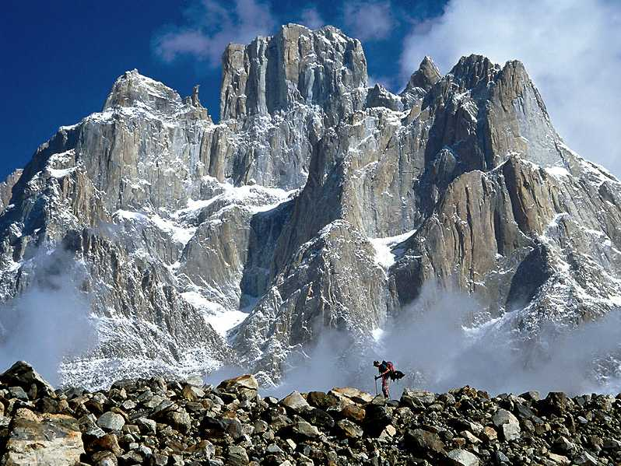
Do not forget your umbrella. I have to water the plants. God

Slide 17
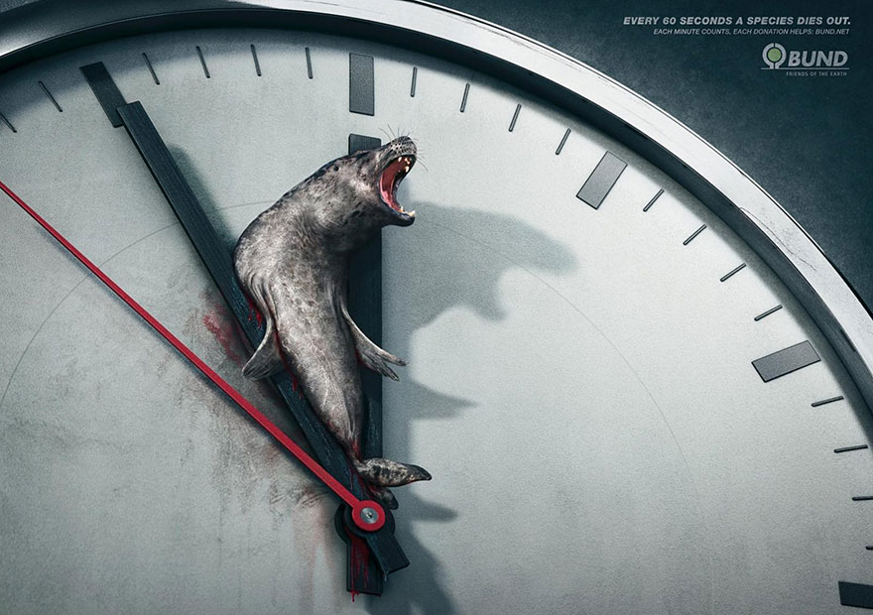

Slide 18
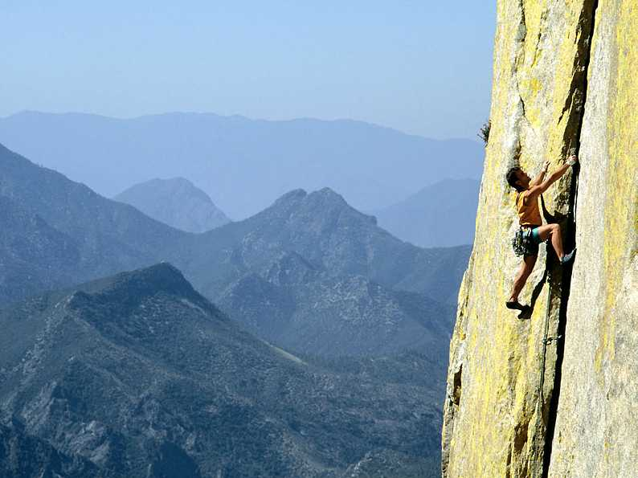
In my opinion, you are the most beautiful creature in the world OK, I’m biased. God

Slide 19
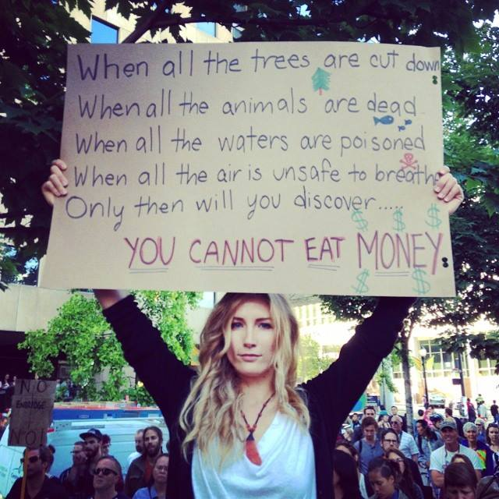

Slide 20
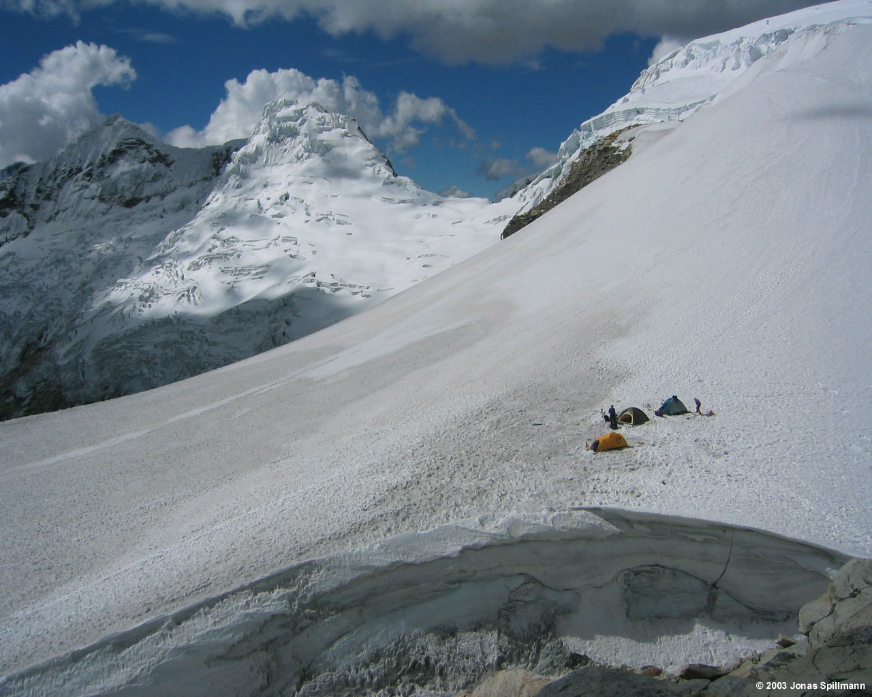
Can you imagine what air would cost, if someone else provided it? God

Slide 21
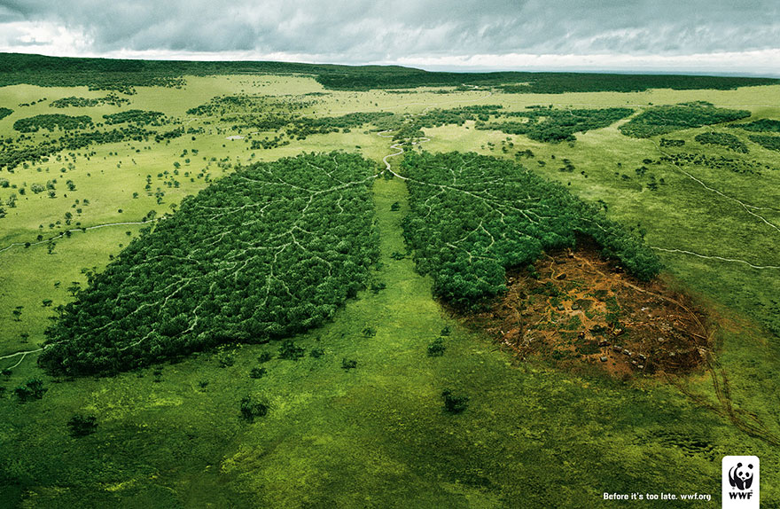

Slide 22
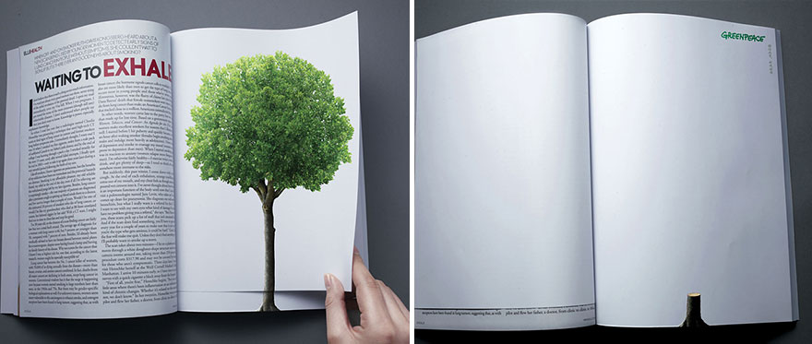

Slide 23
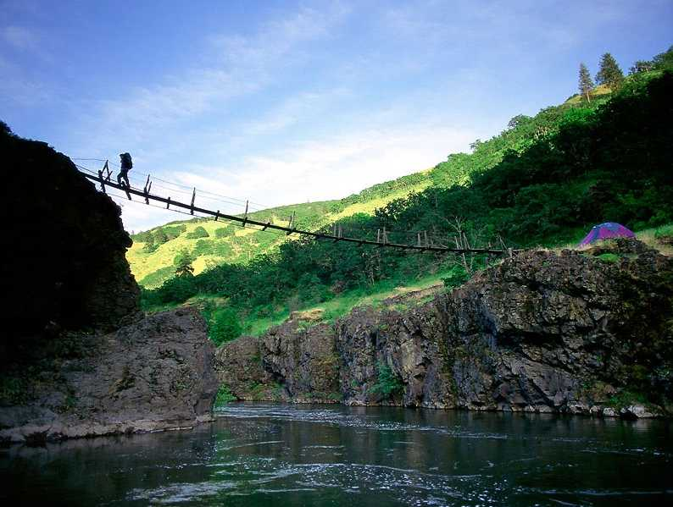
Come to my house on Sunday, before the game. God

