Slide 1
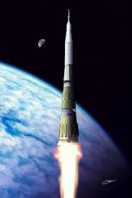
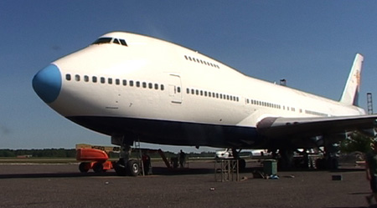
Well I think it's fine, building jumbo planes Or taking a ride on a cosmic train. Switch on summer from a slot machine. Get what you want to if you want, 'cause you can get anything.
WHERE DO THE CHILDREN PLAY? : CAT STEVENS (1970)

Slide 2
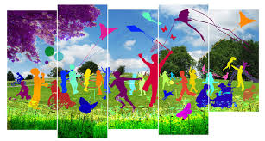
I know we've come a long way, We're changing day to day, But tell me, where do the children play?

Slide 3
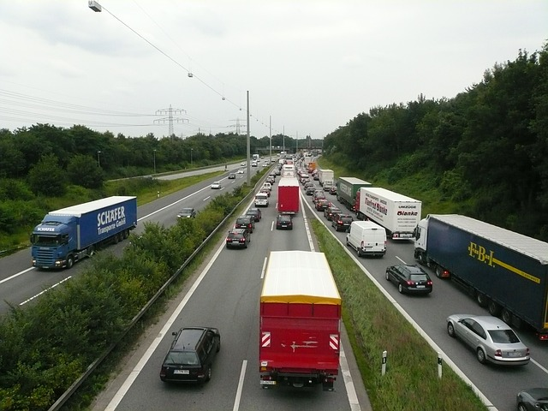
Well you roll on roads over fresh green grass For your lorry loads pumping petrol gas. And you make them long, and you make them tough. But they just go on and on, and it seems that you can't get off.

Slide 4
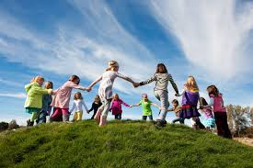
Oh, I know we've come a long way, We're changing day to day, But tell me, where do the children play?

Slide 5
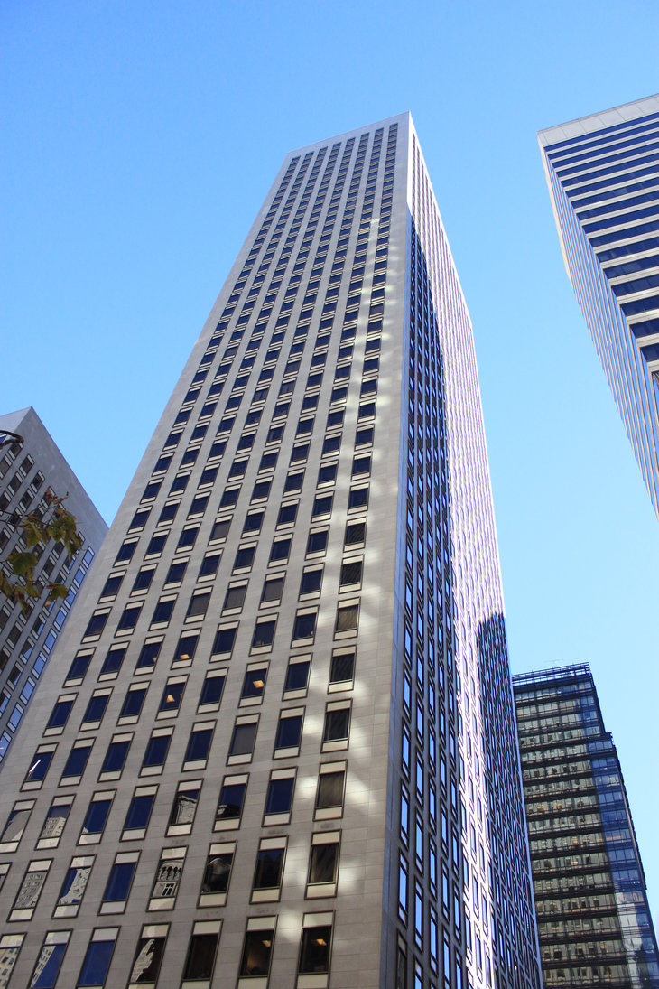
When you crack the sky, scrapers fill the air. Will you keep on building higher 'til there's no more room
up there? Will you make us laugh,
will you make us cry? Will you tell us when to live, and will you tell us when to die?

Slide 6
I know we've come a long way, We're changing day to day, But tell me, where do the children play?

