Slide 1
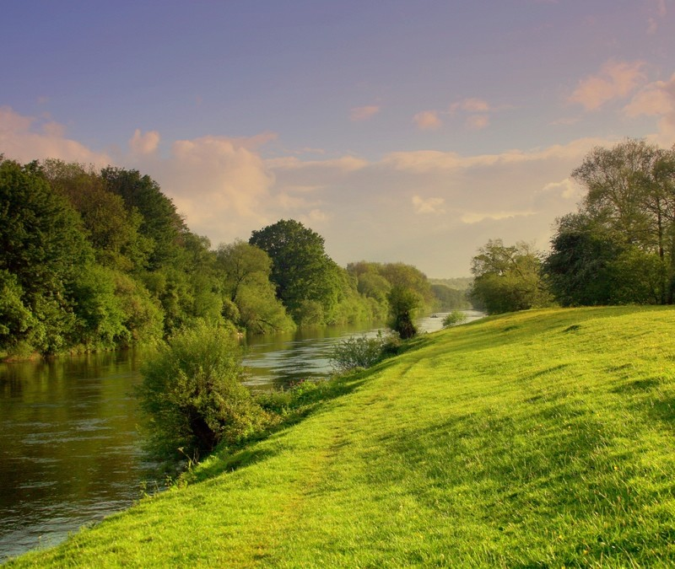
Module 2: Imperatives and Insights
The Biblical Mandate
for Creation Care

Slide 2
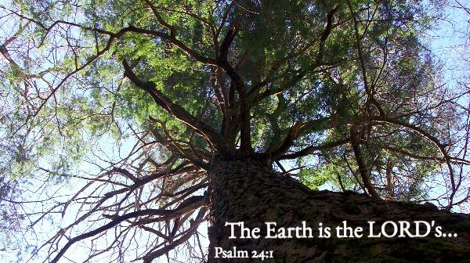
Stewardship
Genesis 1:28-30, 2:15

Slide 3
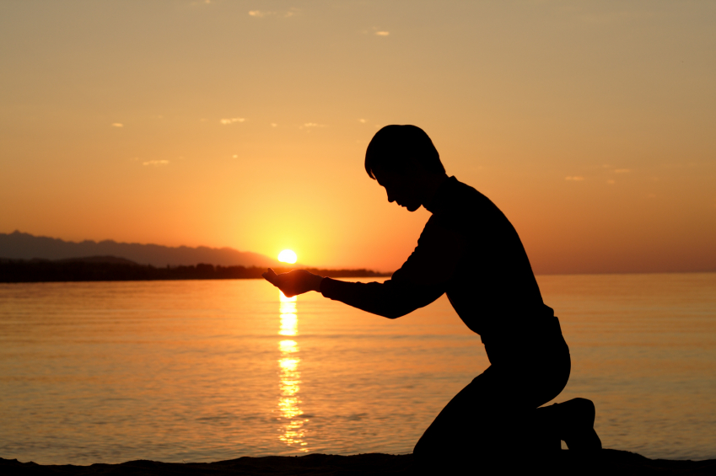
“The Lord God took the man and put him in the Garden of Eden to work it and take care of it…”
Genesis 2:15 TNIV

Slide 4
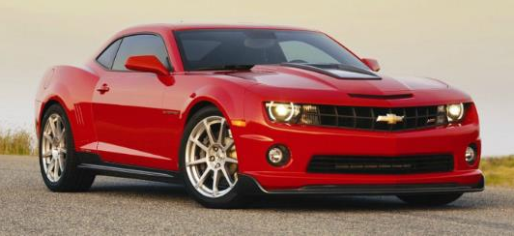
Stewards: managers and caretakers of his gifts

Slide 5
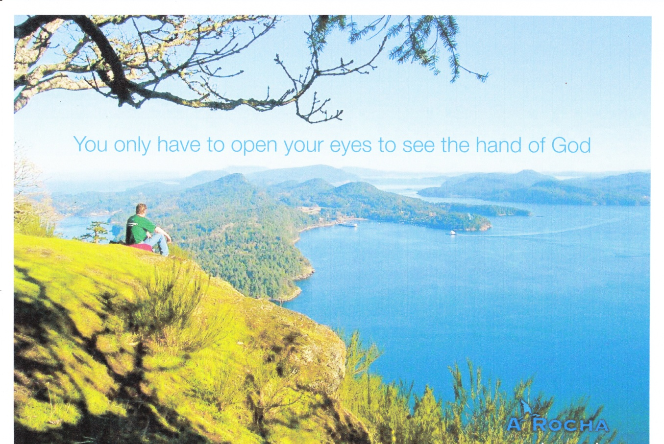
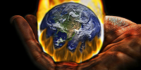
Sanctity
“a condition deserving of great respect”
Psalm 19:1-6,Romans 1:20

Slide 6
Creation deserves great respect because God:
brought it into being (Genesis 1-2, Psalm 104:24,30) so regards it as precious and with intrinsic value
has an ongoing relationship with it: delighting in, sustaining, providing, caring (Deuteronomy 32:1-2, Job 37:14-18, Psalm 96:10-13/104:25- 29, Isaiah 43:20-21, Matthew 6:26)
loves it so much that he sacrificed his Son for its redemption (“cosmos” in John 3:16)
is revealed and explained through it
(Joshua 2:10-11, Psalm 104:24, Romans 1:20)
teaches us and speaks to us through it (Job 12:7-9, Isaiah 11:9, Romans 1:20-21)

Slide 7
4 facts about species in Genesis
God created them (1:11-12,20-21,24-25)
He then blessed them (1:22)
He protected them (6:19-21,7:8-10)
He promised never again to destroy them (9:8-17)
“...all ground is holy because God walked on it...”
- Frederick Buechner

Slide 8


Slide 9
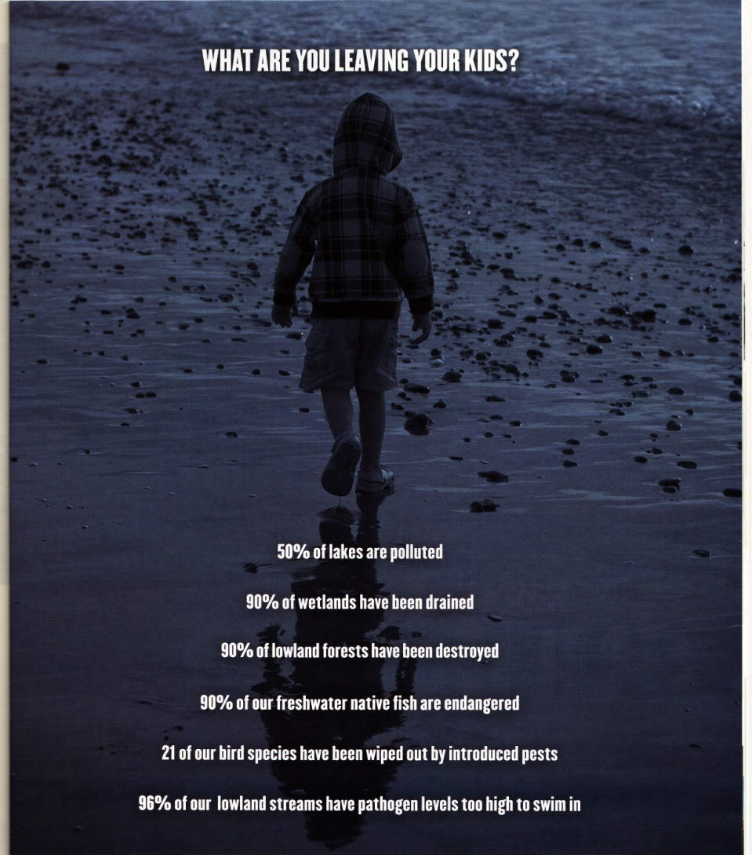
Sustainability
Deuteronomy
20:19,22:6-7
Exodus 20:8-11
Exodus 23:10-12
Leviticus 22:28, 25:1-54
Psalm 45:17, 71:18, 78:4, 89:1

Slide 10
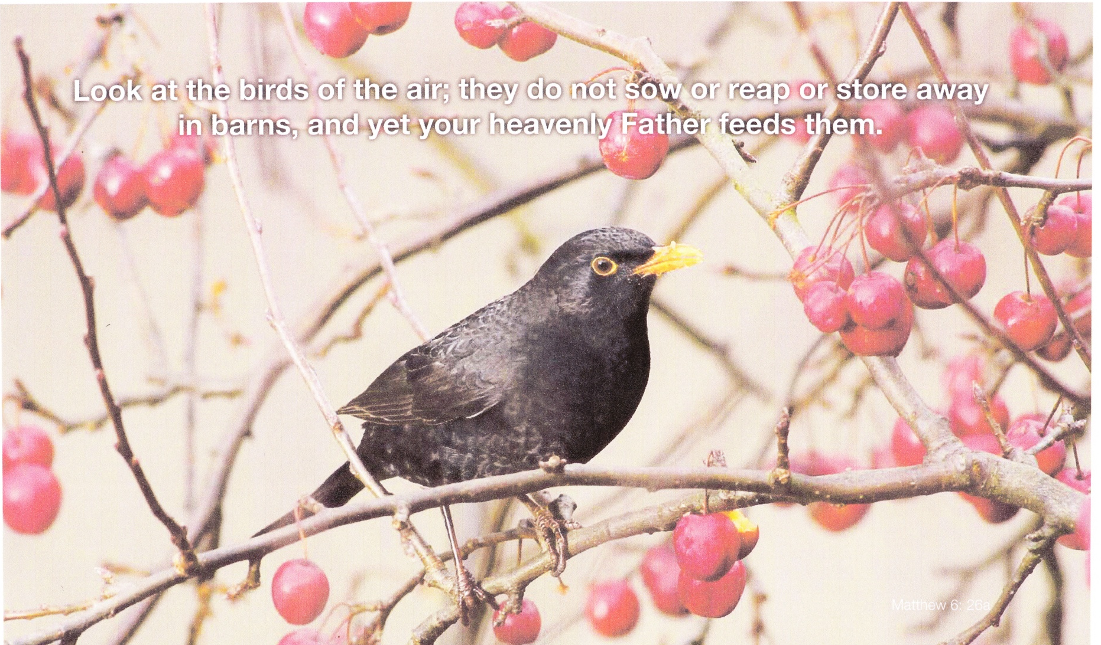
Similarity
John 1:3, Colossians 1:15-20, Hebrews 1:2-3, Romans 8:29, I John 4:17

Slide 11
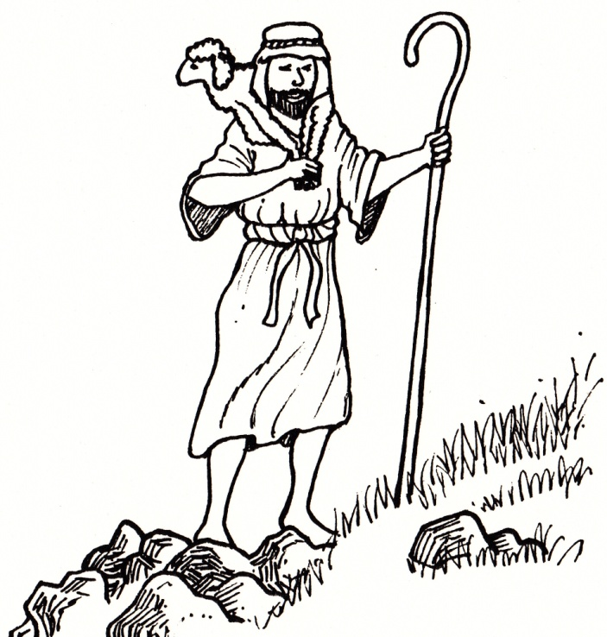
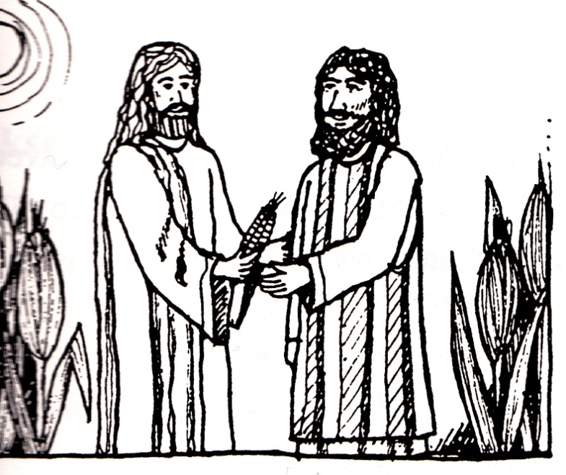
Jesus was a greenie
Even though Jesus did not explicitly address environmental ethics, Creation Theologists, such as Sean MacDonagh, maintain he showed his followers that he had concern for the environment.
This was shown in two different ways...

Slide 12
Events and incidents involving nature:
Examples:
A close look at Jesus’ public life shows that he preached mainly in natural surroundings.
Some key moments in Jesus’ ministry are in nature:
  Sermon on the Mount
  On the Lake (storm)
  Baptised in a river (natural surroundings)
  When preparing for his betrayal, he placed himself in the Garden of Gethsemane, surrounded by natural things, to be alone with God.

Slide 13
References to nature in his teaching
Examples: Matthew 6:10,26-30; Mark 16:15
Jesus used nature on many occasions as a theme in his parables...
  The Sower and the Seeds (Mark 4:3-9; Matt 13:3-9; Luke 8:5-8)
  The Grain of Wheat (John 12:24)
  The Weeds in the Grain or the Tares (Matt 13:24-30)
  The Net (Matthew 13:47-50)
  The Seed Growing Secretly (Spontaneously) or The Patient Husbandman (Mark 4:26-29)
  The Mustard Seed (Matt13:31f.;Mark 4:30-32; Luke 13:18 f.)
  The Leaven (Matthew 13:33; Luke 13:20 f.)
  The Budding Fig Tree (Matt 24:32 f.; Mark 13:28 f.; Luke 21:19-31)
  The Barren Fig Tree (Luke 13:6-9)
  The Birds of Heaven (Matthew 6:26; Luke 12:24)
  The Flowers of the Field (Matt 6:28-30; Luke 12:27f.)
  The Vultures & the Carcass (Matt 24:28; Luke 17:37)
  The Tree and its Fruits (Matthew 7:16; Luke 6:43-49)
  The Weather Signs (Luke 12:54-56; cf. Matthew 26:2 f.; Mark 8:11-13)

Slide 14
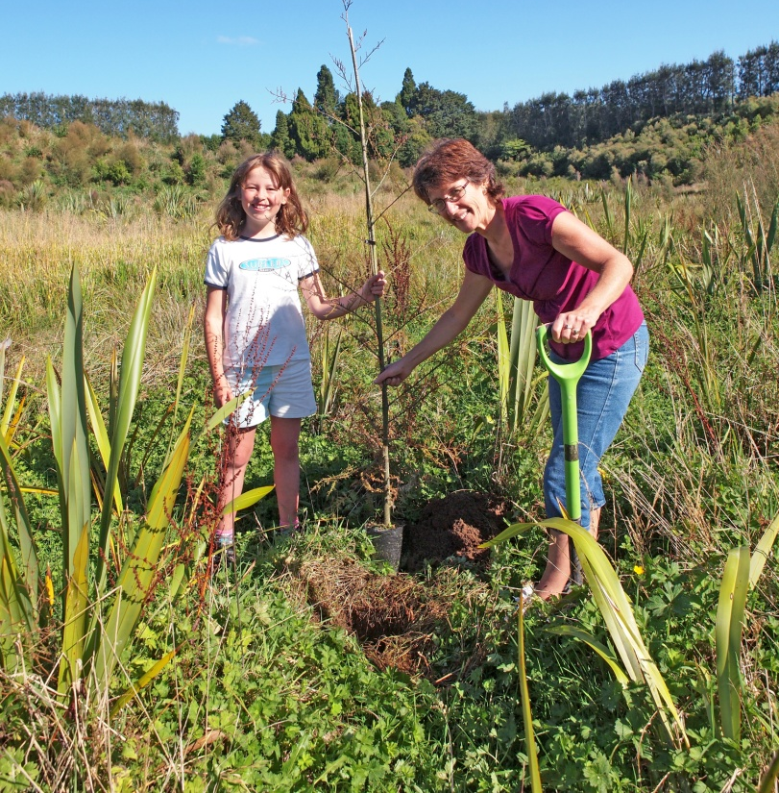


Showing Honour
Psalm 29:1-2, John 4:23
God intended all creation to praise him and bring him glory (I Chronicles 16:29-34, Nehemiah 9:6, Psalm 8:1-9, Isaiah 55:12-13, Revelation 5:13)
Acts of worship

Slide 15
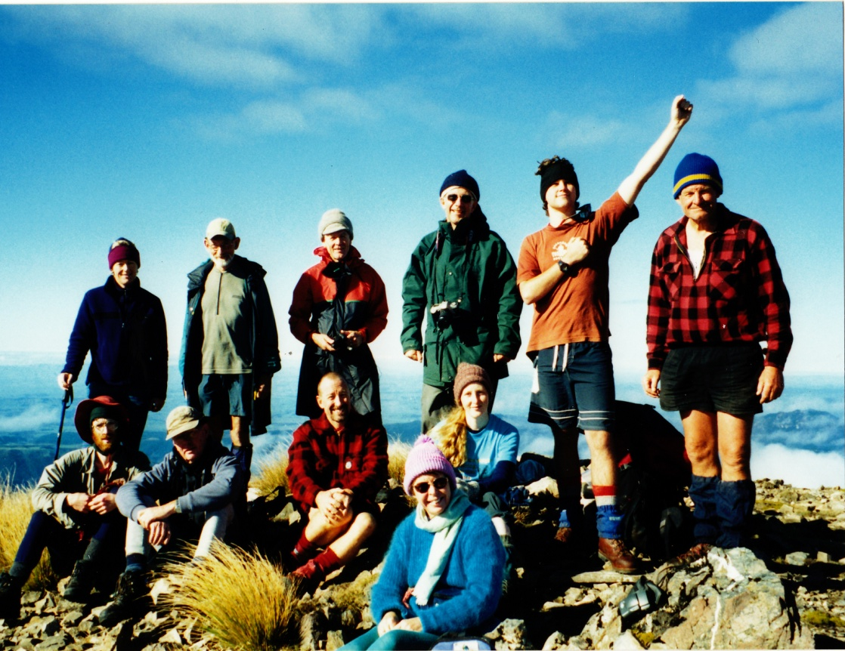
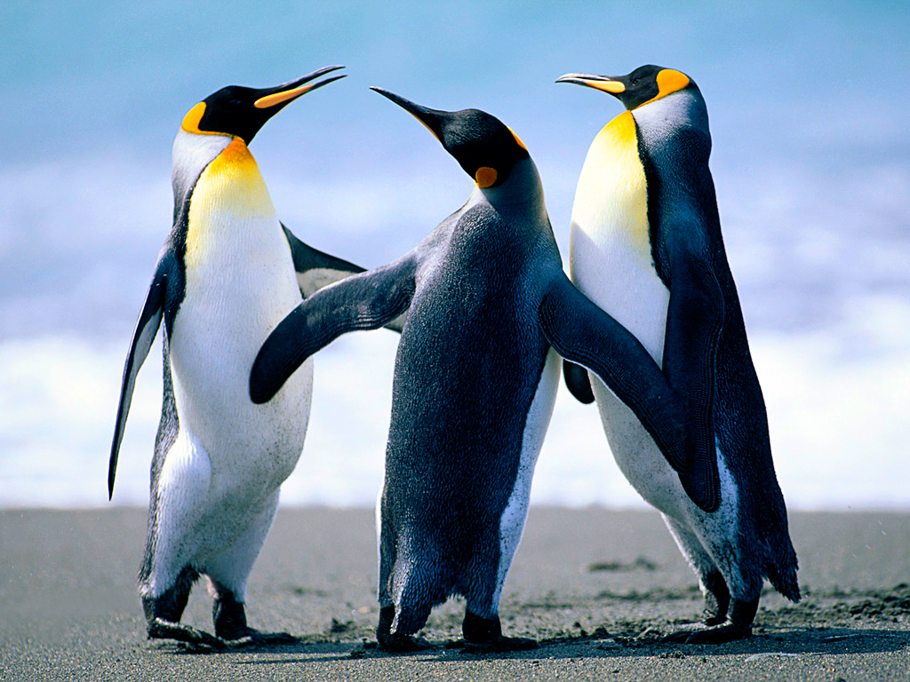
Salvation
Genesis 6-9 (Noah), Acts 3:21, Romans 8:18-25, Ephesians 1:10, Colossians 1:20, Revelation 21:5

Slide 16
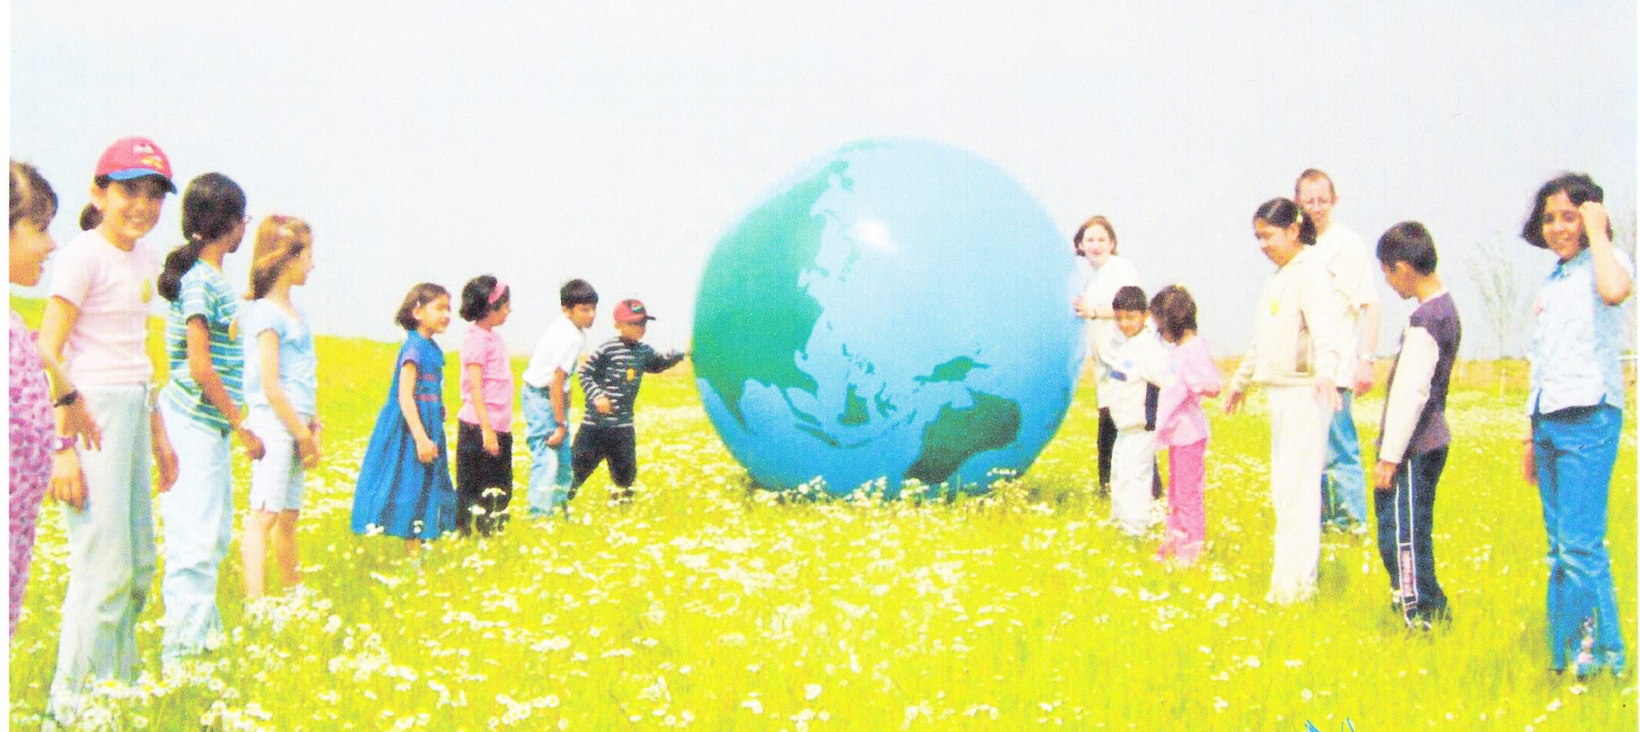
Sensitivity
I Chronicles 12:32, Ephesians 5:16

Slide 17
tewardship
anctity
ustainability
imilarity
howing honour
alvation
ensitivity

Slide 18
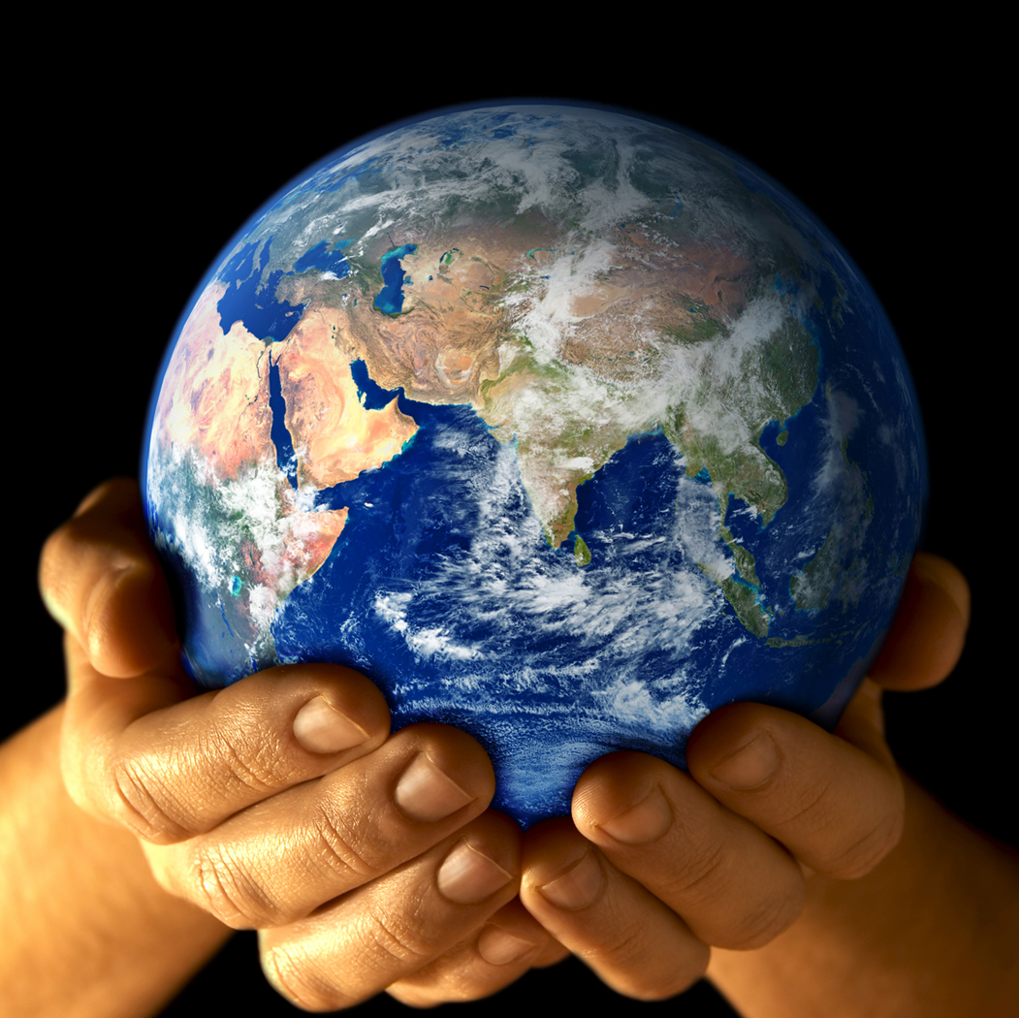
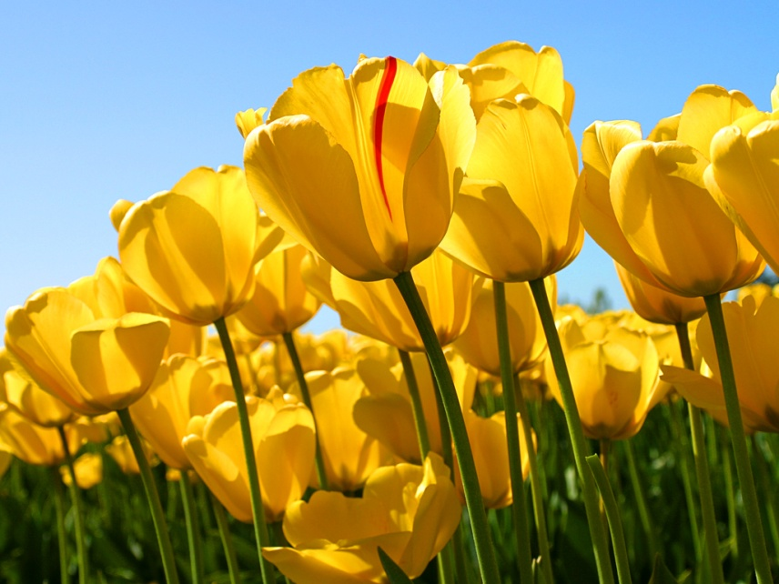
Caring for what God has made is one of the dominant values of the Judeo-Christian ethic. It echoes throughout Scripture!
It was mandated by God! The Bible makes it clear that humans, made in God’s image, have unique responsibility for the wellbeing of creation.

Slide 19
Creation Theology
(Green Theology)
As a result of Christians re-evaluating their position on the environment there has been a push towards a Creation-Centred Theology
Creation Theology is concerned with the cherishing of all life and all people, as gifts from God.
It encourages Christians to focus on God’s creative power. By valuing and appreciating God’s creative power, we as humans would not purposely destroy the environment.

