Slide 2
Welcome to the
PLANETCARERS
Seminar

Slide 3
Today we will consider why
Christians should be involved in environmental stewardship

Slide 4
God saw everything that he had made, and indeed, it was very good.
Genesis 1:31 NRSV

Slide 5
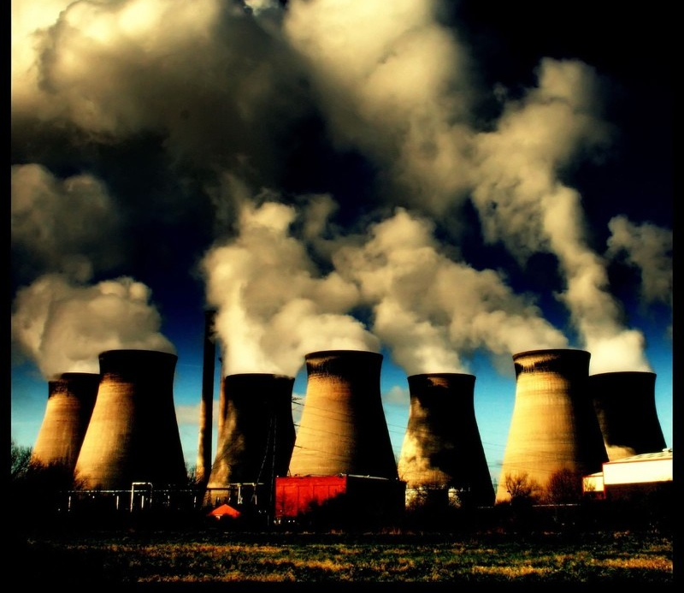
The Lord took the man and put him in the Garden of Eden to work it and take care of it.
Genesis 2:15 TNIV

Slide 6
I looked at the earth, and it was empty and formless. I looked at the heavens, and there was no light. I looked at the mountains and hills, and they trembled and shook. I looked, and all the people were gone. All the birds of the sky had flown away. I looked, and the fertile fields had become a wilderness.
Jeremiah 4:22-26 NLT

Slide 7
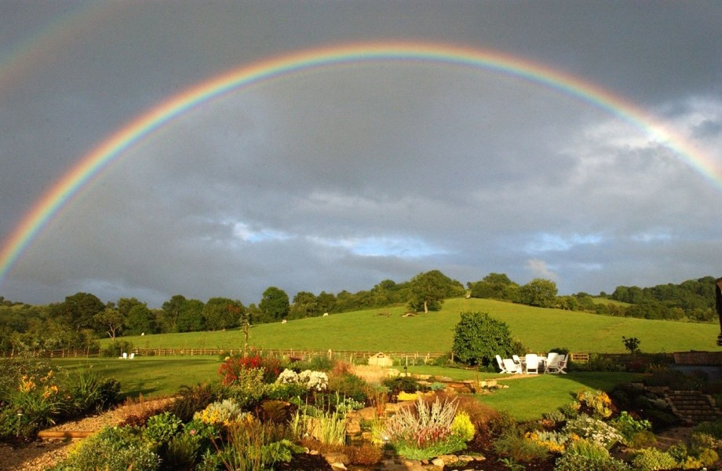
“Never again will the floodwaters destroy all life.
When I see the rainbow in the clouds I will remember the eternal covenant between God and every living creature on earth...”
Genesis 9:15-17 NLT

Slide 8
In this seminar we will
address some timely topics…

Slide 9
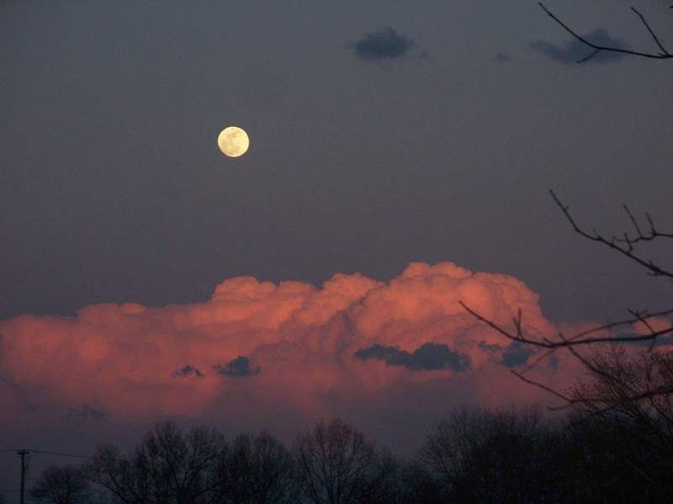
Module 1: A Perfect Storm
The Reality of the Ecological Crisis

Slide 10
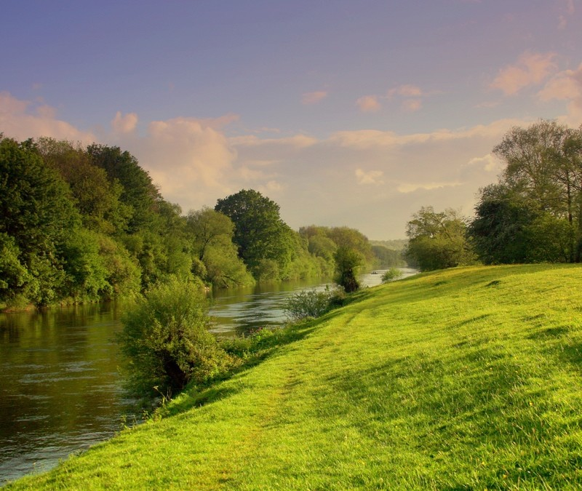
Module 2: Imperatives and Insights
The Biblical Mandate
for Creation Care

Slide 11
Module 3: An Inconvenient Truth
Occasional Objections
and Everyday Excuses

Slide 12
Module 4: Twin Transformations
Creation Care as a Matter of Morality and a Means of Mission

Slide 13
Module 5: For Such A Time As This
Translating Theory into Practice

Slide 14
WARNING:
This seminar could change your life!

Slide 15
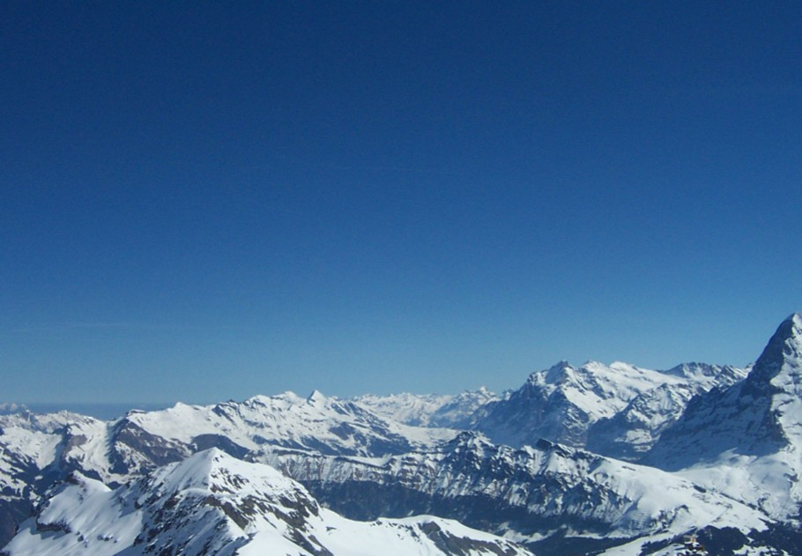
Are you ready to begin?
Please turn to the Module 1 page
in your seminar folder

