Slide 1
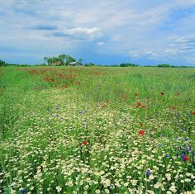
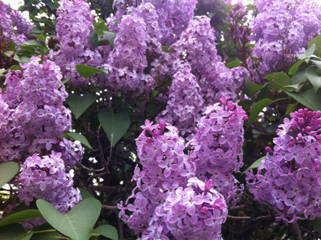
.
TAR AND CEMENT: VERDELLE SMITH (1966)
The town I came from was quiet and small we played in the meadows where the grass grew so tall in summer the lilacs would grow everywhere the laughter of children would float in the air

Slide 2
As I grew older I had to roam far from my family, far from my home into the city, where lives can be spent lost in the shadows of tar and cement.

Slide 3
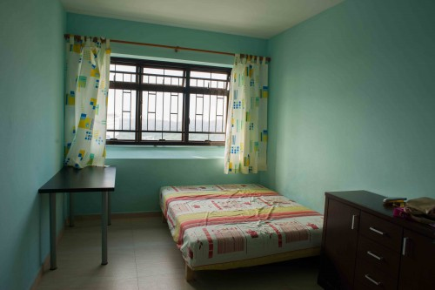
And every night I'd sit alone and learn what loneliness meant up in my rented room above the world of tar and cement.

Slide 4
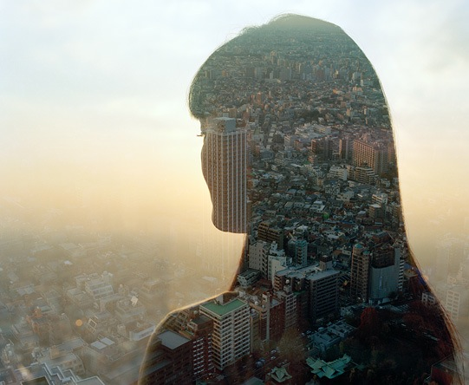
Each day I'd wake up and look at the sky think of the meadows where I used to lie then I'd remember all of that's gone you're in the city, you better push on get what you came for, before it's too late get what you came for, the meadows can wait

Slide 5
So every night I'd sit alone and learn what loneliness meant up in my rented room above the world of tar and cement.

Slide 6
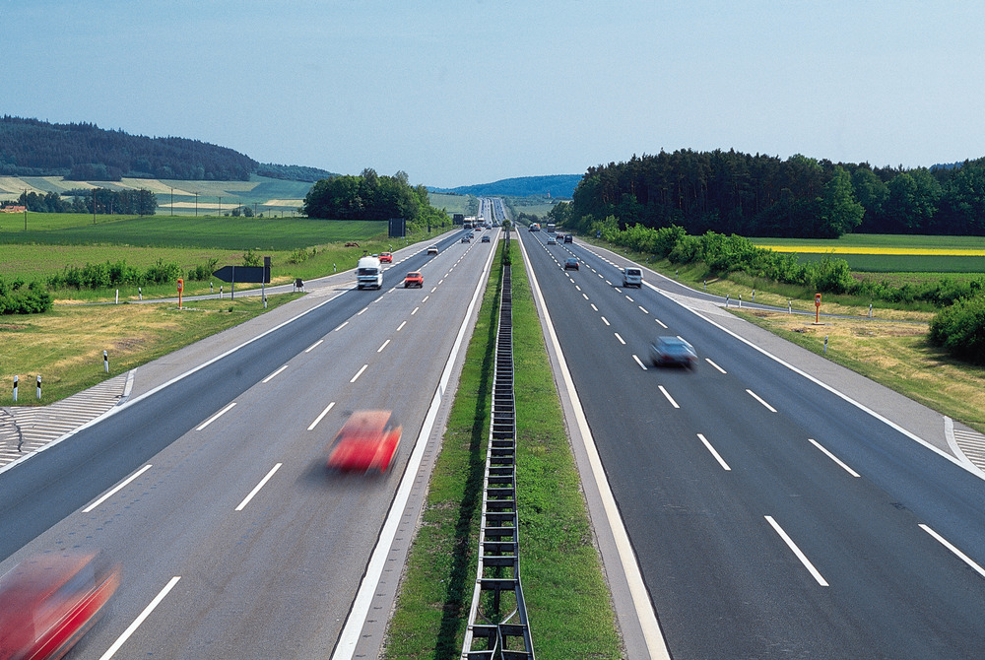
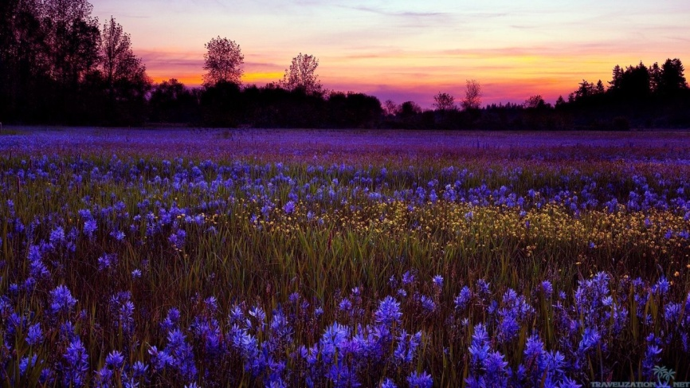
Many years later, tired at last I headed for home to look for my past I looked for the meadows, there wasn't a trace six lanes of highway had taken their place where were the lilacs and all that they meant nothing but acres of tar and cement. Yet I can see it there so clearly now where has it gone? Yes I can see it there so clearly now where has it gone?

Slide 7
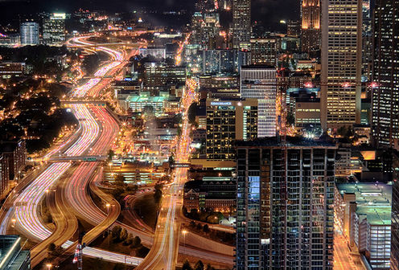
Where are the meadows? (tar and cement) where are the lilacs? (tar and cement) and where is the tall grass? (tar and cement) the laughter of children? (tar and cement) nothing but acres (tar and cement) acres and acres.....(fade to end)

