Slide 1
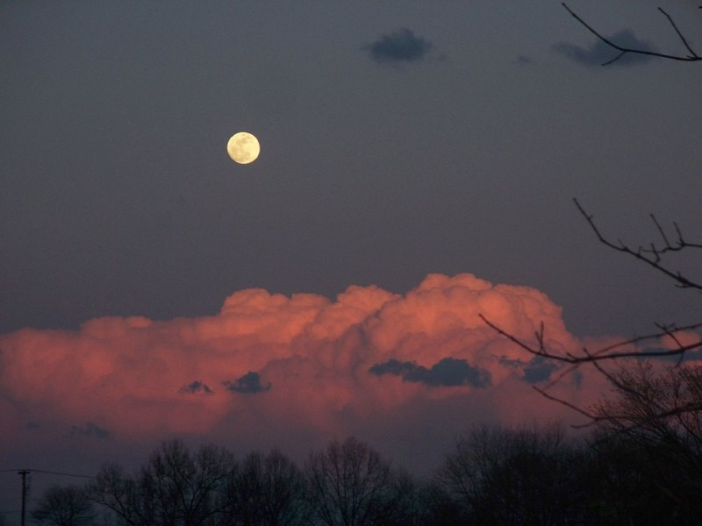
Module 1: A Perfect Storm
The Reality of the Ecological Crisis

Slide 2


Slide 3
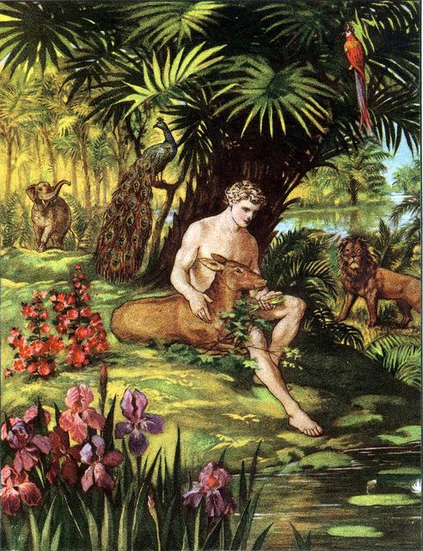
If God came
to tread
the ground in New Zealand today, would he find an “Eden”?

Slide 4
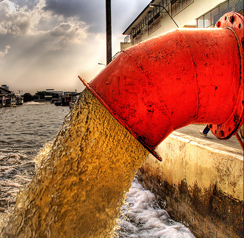
THE NEW ZEALAND SITUATION

Slide 5
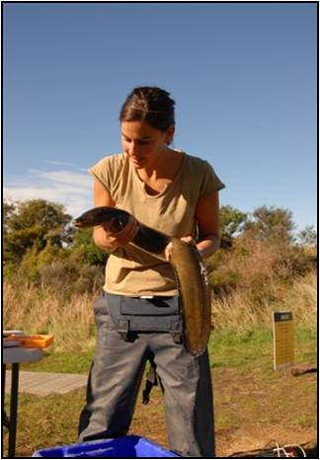
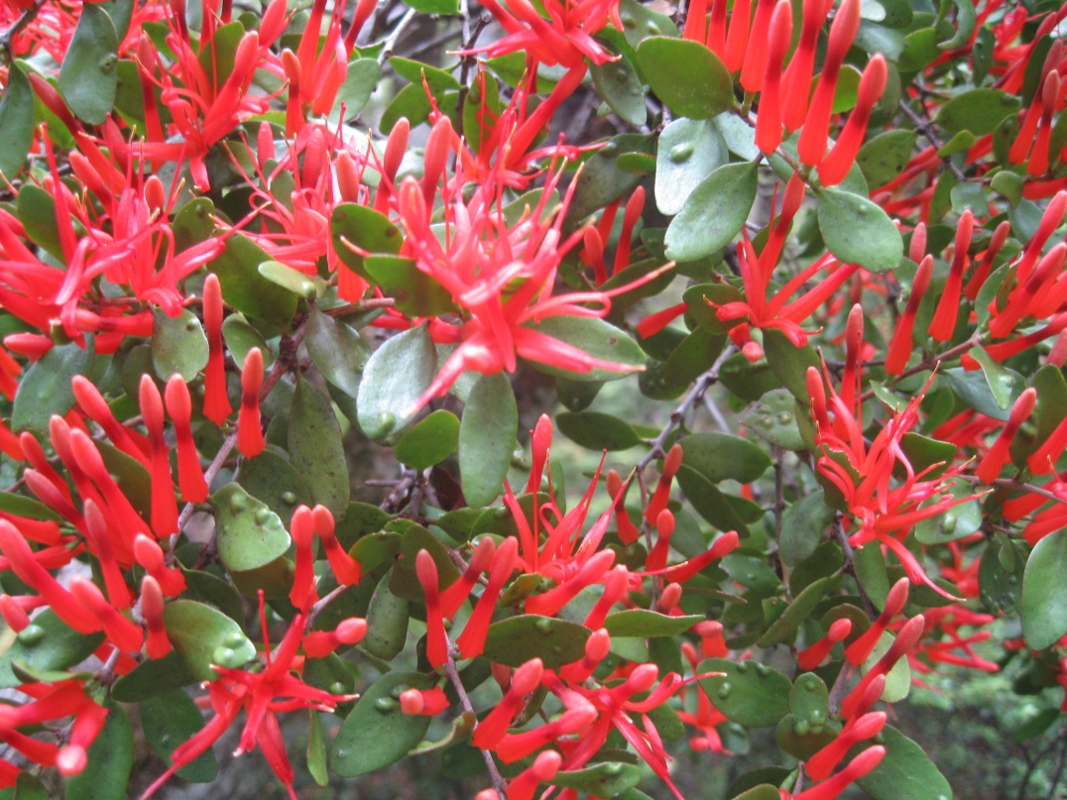
BIODIVERSITY LOSS

Slide 6
List of extinct animals of New Zealand (since human occupation)
Mammals
Greater Short-tailed Bat, Mystacina robusta (1965) (
Waipatia maerewhenua (Dolphin, Oligocene a
SB mammal, thought to be neither therian nor australosphenidan
Birds
Extinctions since mid-19th century European settlement
Auckland Islands Merganser, Mergus australis
Chatham Islands Rail, Cabalus modestus
Dieffenbach's Rail, Gallirallus dieffenbachii
South Island Snipe, Coenocorypha iredalei
North Island Snipe, Coenocorypha barrierensis
New Zealand Quail, Coturnix novaezelandidae
North Island Takahe, Porphyrio mantelli
South Island Kokako, Callaeas cinerea cinerea
Huia, Heteralocha acutirostris
South Island Piopio, Turnagra capensis
North Island Piopio, Turnagra tanagra
Chatham Islands Bellbird, Anthornis melanocephala
New Zealand Little Bittern, Ixobrychus novaezelandiae
\Stephens Island Wren, Traversia lyalii
\Bush Wren, Xenicus longipes
  South Island Bush Wren, Xenicus longipes longipes
  North Island Bush Wren, Xenicus longipes stokesi
  Stewart Island Bush Wren, Xenicus longipes variabilis
Chatham Islands Fernbird, Bowdleria rufescens
Laughing Owl, Sceloglaux albifacies
Chatham Islands Penguin, Eudyptes sp.
Extinctions since 14th century Māori settlement
North Island Adzebill, Aptornis otidiformis
\South Island Adzebill, Aptornis defossor
Eyles' Harrier, Circus eylesi
Haast's Eagle, Harpagornis moorei
Giant Chatham Island Rail or Hawkins' Rail, Diaphorapteryx hawkinsi
\Hodgen's Waterhen or Hodgen's Rail, Gallinula hodgenorum
Snipe-rail, Capellirallus karamu
Chatham Islands Coot, Fulica chathamensis
New Zealand Coot, Fulica prisca
Giant Chatham Island Snipe, Coenocorypha chathamica
New Zealand Owlet-nightjar, Aegotheles novaezealandiae
Grant-Mackie's Wren, Pachyplichas jagmi
Yaldwyn's Wren or Stout-legged Wren, Pachyplichas yaldwyni
Long-billed Wren, Dendroscansor decurvirostris
Chatham Islands Raven, Corvus moriorum
New Zealand Raven, Corvus antipodum
  \North Island Raven, Corvus antipodum antipodum
  South Island Raven, Corvus antipodum pycrafti
Nw Zealand Musk Duck or De Lautour's Duck, Biziura delautouri
hatham Islands Duck, Pachyanas chathamica
Reptiles
Ankylosaur, unidentified (Cretaceous)
Compsognathus-like creature (Late Jurassic)
Hypsilophodont, unidentified (Cretaceous)
Joan Wiffen's Theropod (Cretaceous)
Kawekaweau, Hoplodactylus delcourti (1870)
Narrow-bodied Skink, Oligosoma gracilicorpus
Northland Skink, Cyclodina northlandi (Late Holocene)
Theropod, unidentified (Cretaceous)
Titanosaur (Cretaceous)
Head of Kaiwhekea katiki
Mauisaurus, Mauisaurus haasti (Late Cretaceous,
Moanasaurus, Moanasaurus mangahouangae (Late Cretaceous)
Nothosaur, unidentified, (Triassic)
New Zealand Plesiosaur, Kaiwhekea katiki (Late Cretaceous,
Waipara mosasaur, Prognathodon waiparaensis (Late Cretaceous,
Amphibians
Aurora frog, Leiopelma auroraensis
Markham's frog, Leiopelma markhami
Waitomo frog, Leiopelma waitomoensis
Stereospondyl – [1]
Fish
New Zealand grayling, Prototroctes oxyrhynchus (1930s)
New Zealand white shark, Carcharodon angustidens (Late Oligocene, 26 M years)
Giant opah, Megalampris keyesi (Late Oligocene, 26 M years)
Insects
Mecodema punctellum
Molluscs
Placostylus ambagiosus gardneri Land snail, Recent
Placostylus ambagiosus hinemoa Land snail, Recent
Placostylus ambagiosus lesleyae Land snail, Recent
Placostylus ambagiosus priscus Land snail, Recent
Placostylus ambagiosus spiritus Land snail, Recent
Placostylus ambagiosus worthyi Land snail, Recent
70 extinctions
New Zealand Pink-eared Duck or Scarlett's Duck, Malacorhynchus scarletti
Finsch's Duck, Chenonetta finschi
North Island Goose, Cnemiornis gracilis
snail, Recent
South Island Goose, Cnemiornis calcitrans
New Zealand Swan, Cygnus atratus sumnerensis
Scarlett's Shearwater, Puffinus spelaeus (600 BP)
Moa
  Bush Moa, Anomalopteryx didiformis
  Upland Moa, Megalapteryx didinus/benhami
  Heavy-footed Moa, Pachyornis elephantopus
  Crested Moa, Pachyornis australis
  Mappin's Moa, Pachyornis geranoides
  Stout-legged Moa, Euryapteryx gravis
  Coastal Moa, Euryapteryx curtus
  Eastern Moa, Emeus crassus
  North Island Giant Moa, Dinornis novaezealandiae
  Giant Moa, Dinornis robustus
Waitaha penguin, Megadyptes waitaha^{[1]}

Slide 7
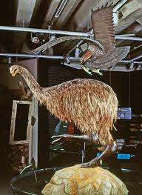
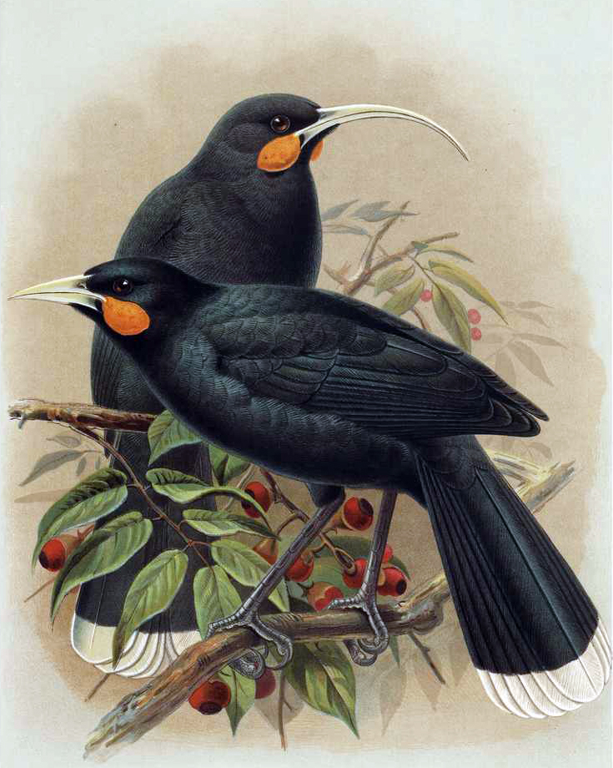
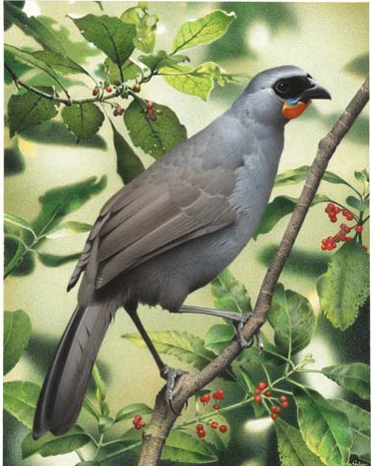
South Island kokako:
declared extinct 2007
Haast’s Eagle:
16 kg.
3m wing span
Moa:
9 species
Huia: last seen 1907

Slide 8
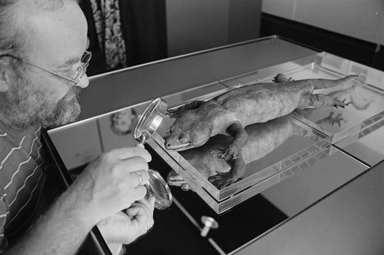
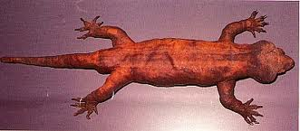
NZ Giant Gecko
(Kawekaweau)
Length 630mm

Slide 9
2800
threatened species
DoC Threatened Species manual
100% of our terrestrial mammals and frogs
85% of our vascular plants
50% of our birds
800 species are in acute or chronic decline.
Only 184 species are receiving help.

Slide 10
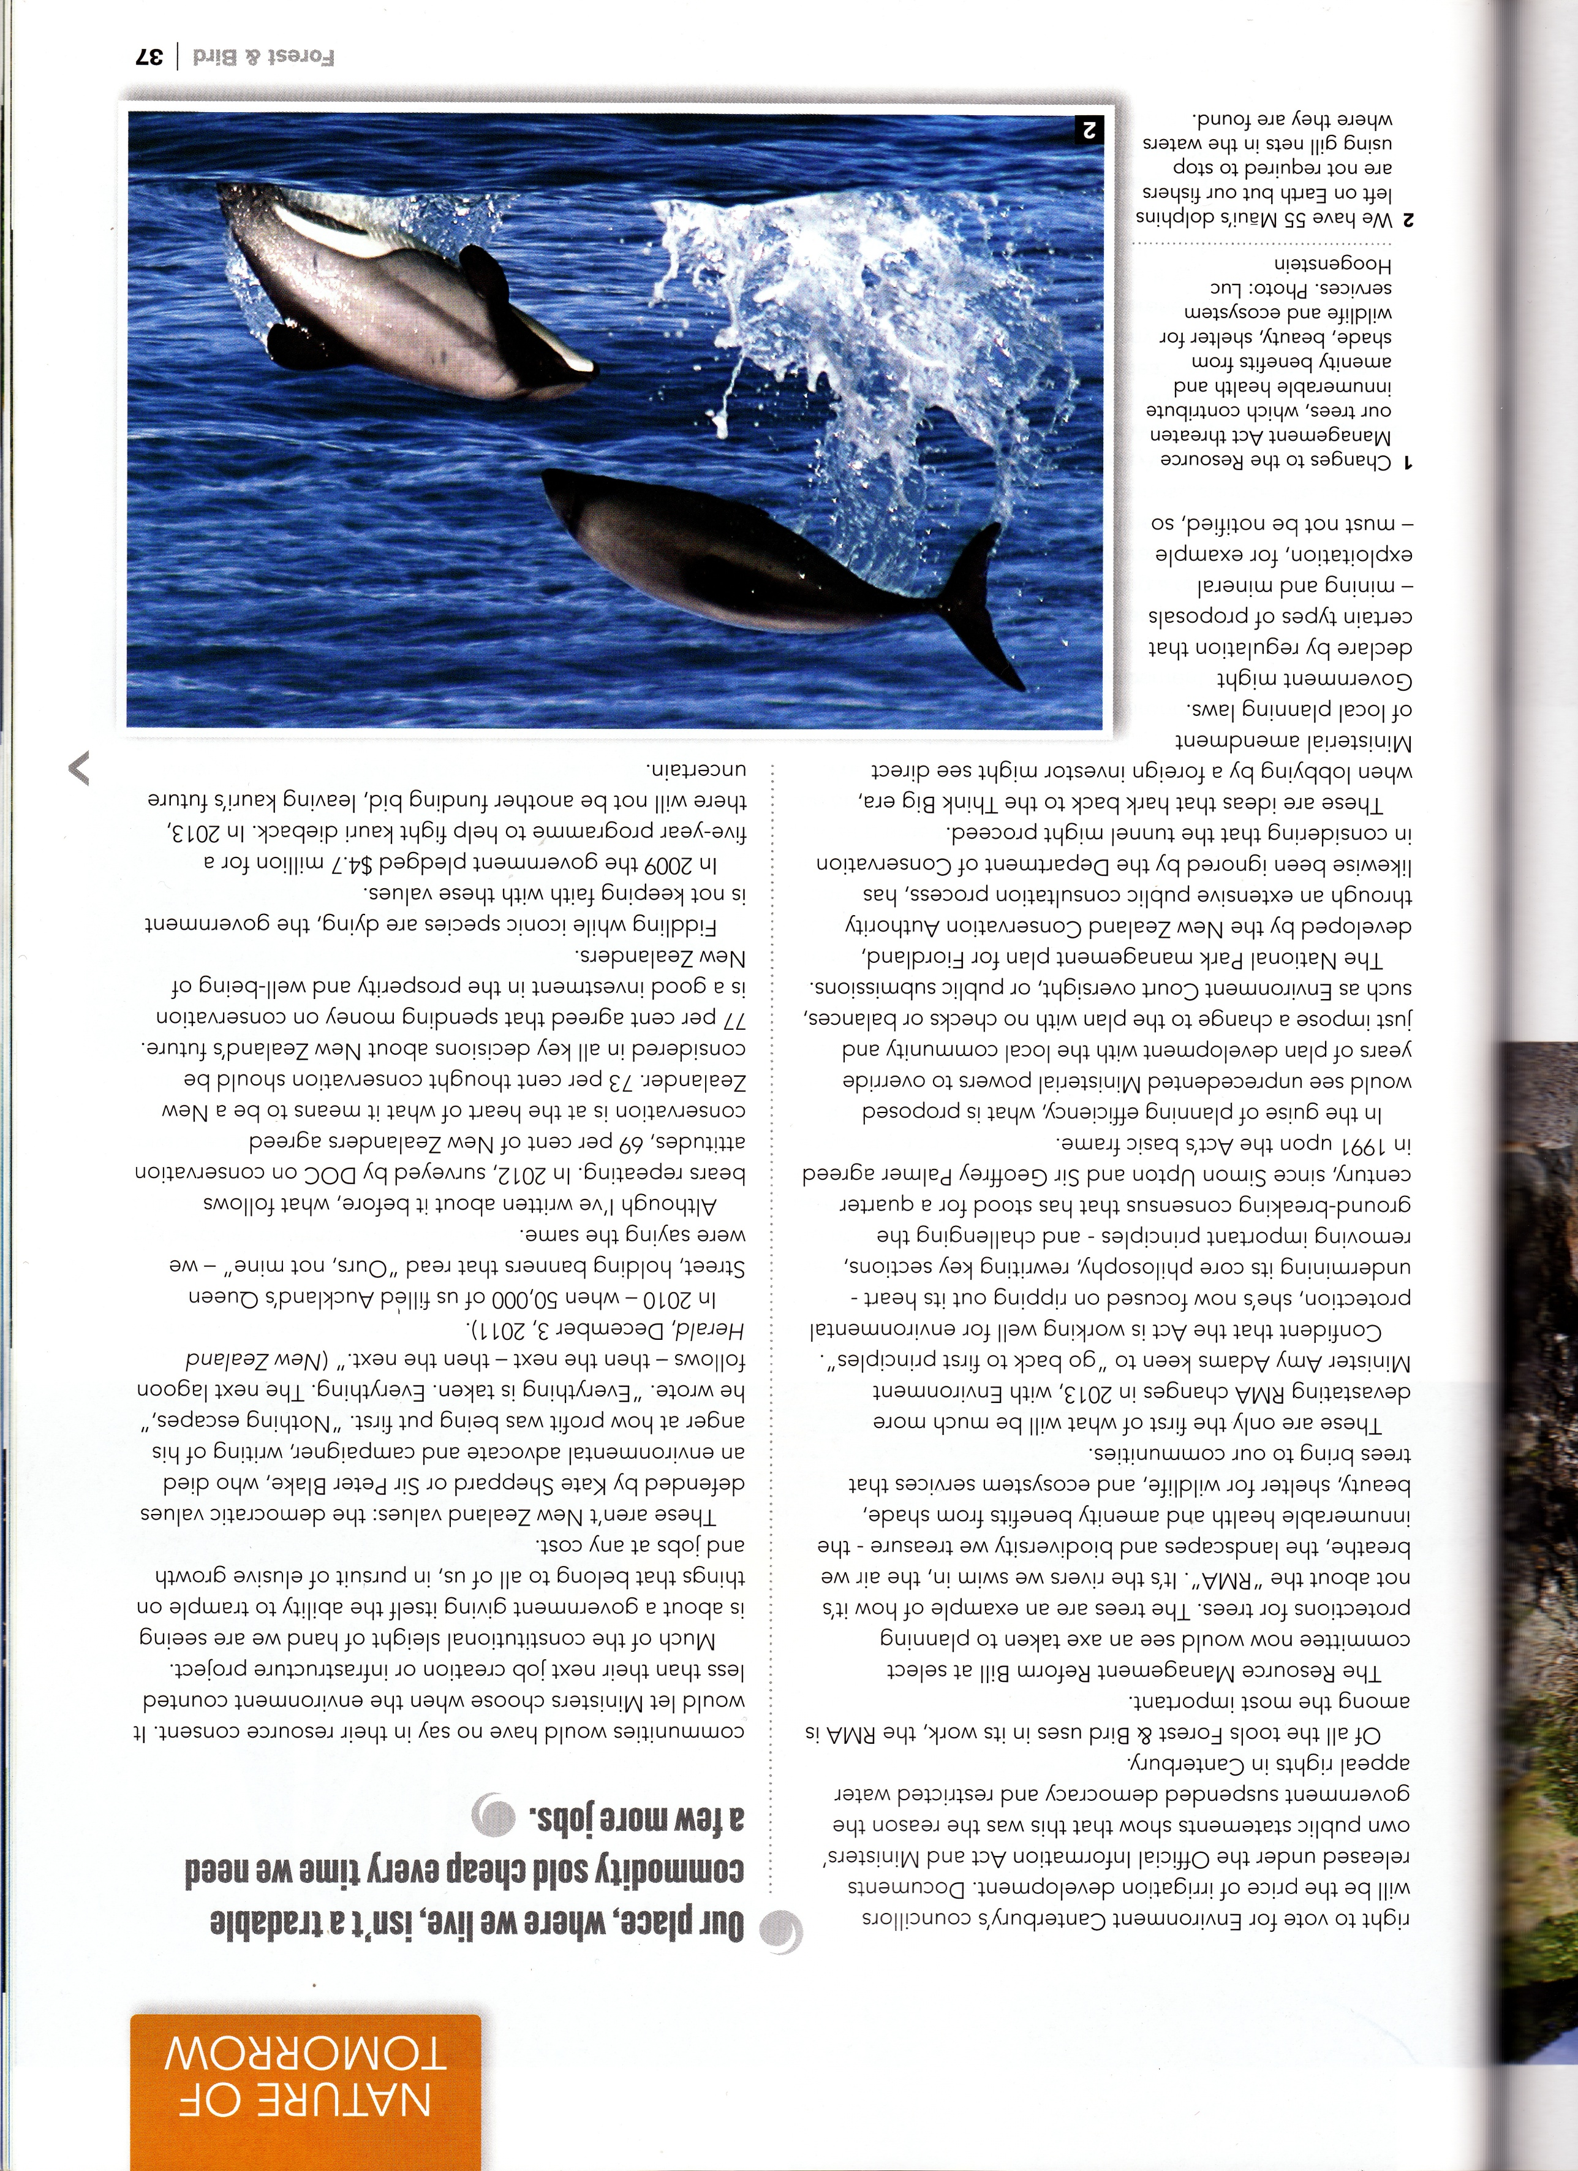
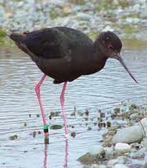
Maui Dolphin
55 left
Black stilt
180 left
Critically Endangered

Slide 11
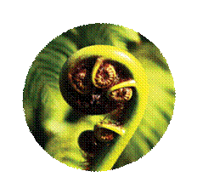
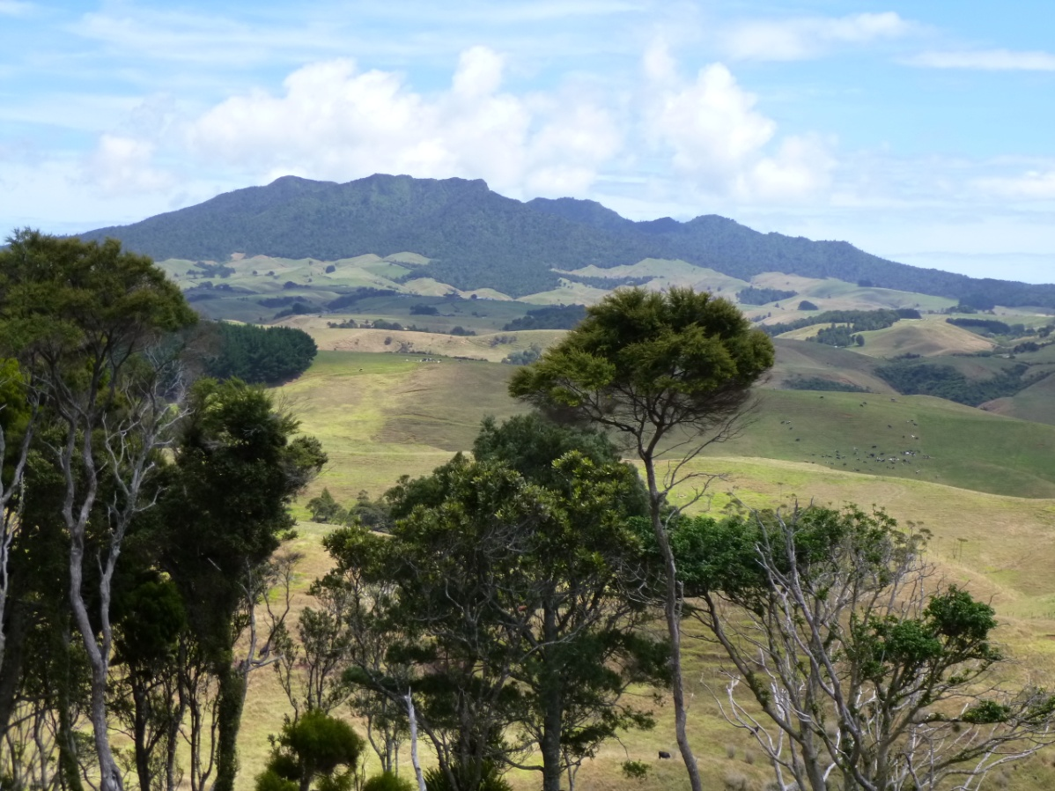
HABITAT DESTRUCTION

Slide 12
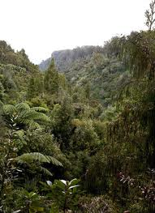
Native Forest Cover
Pre-human: 85%
1840: 56%
Today: 23%

Slide 13
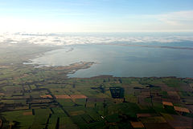
90% of
- lowland forests destroyed
wetlands drained
lowland rivers polluted
(+ half our lakes)
10% of NZ severely erodible
Thousands of contaminated soil sites
Lake Ellesmere –
NZ’s most polluted lake
46th in the world for protecting habitats of endangered species

Slide 14
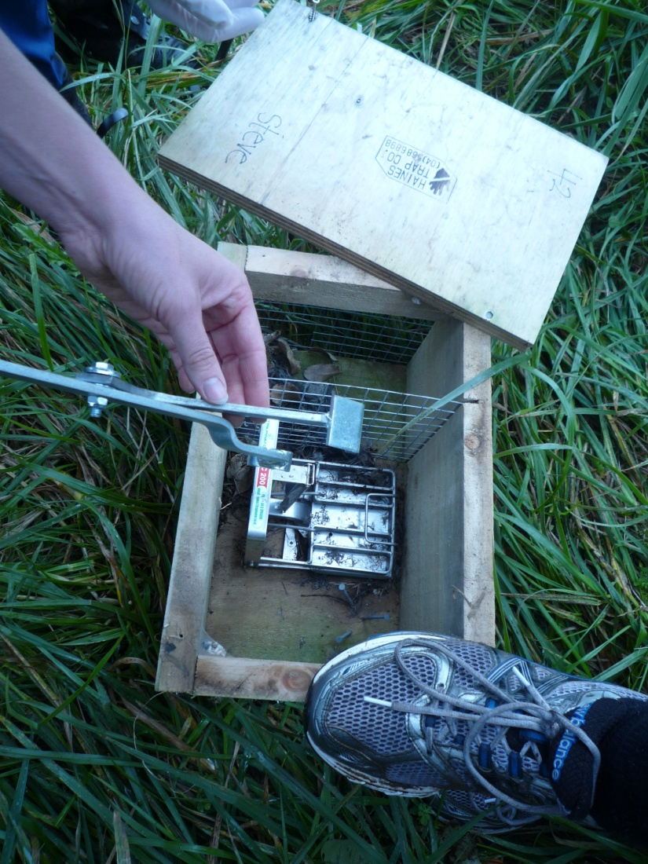
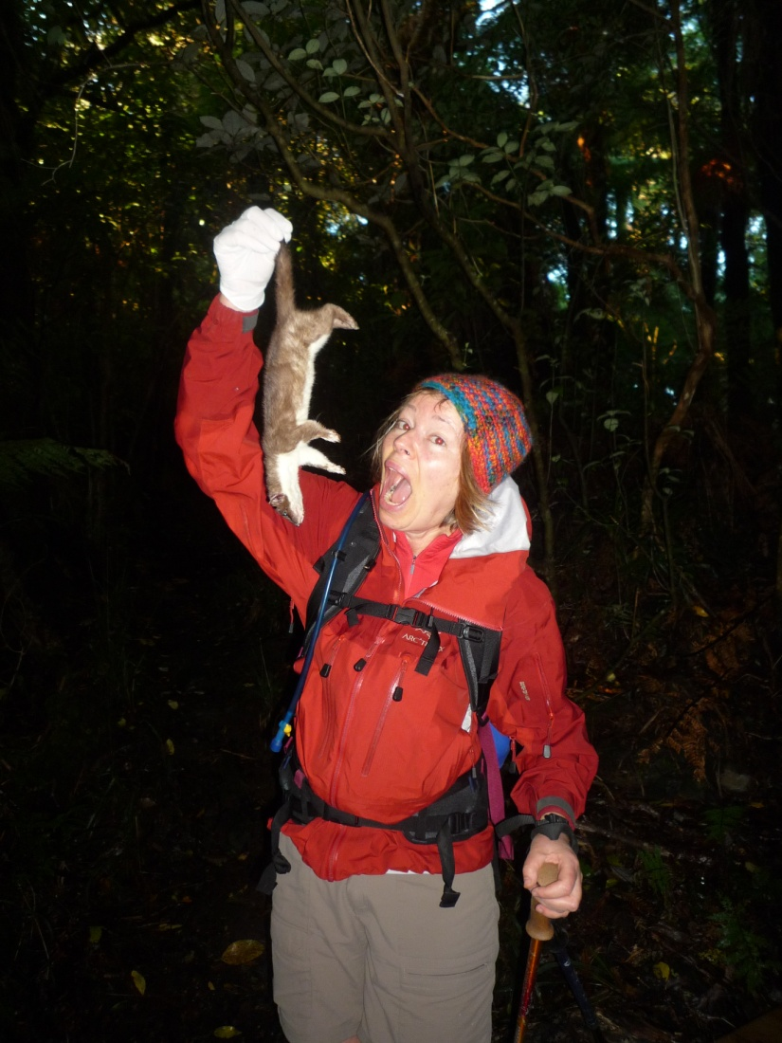
INVASIVE SPECIES

Slide 15
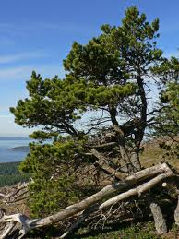
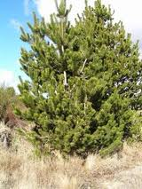
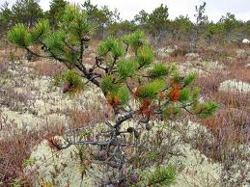
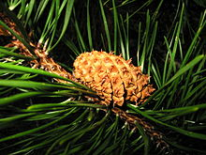
Lodgepole Pine
(Pinus contorta, Dougl.)
Introduced about 1880.
Seeds profusely.
Spreads rapidly.

Slide 16
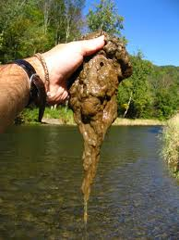
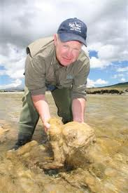
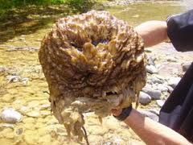
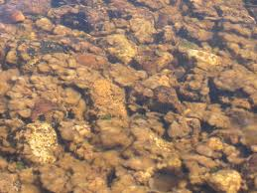
Didymo
(“rock snot”)
First reported in 2004 Currently in 150
South Island Rivers

Slide 17
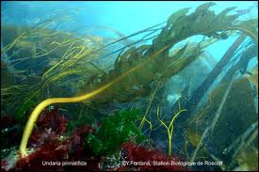
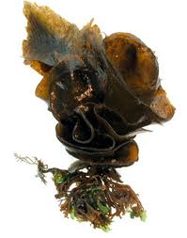
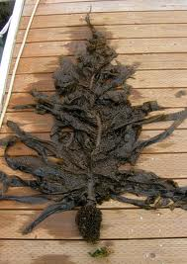
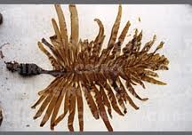
Undaria
Came to NZ in the 1980s.
Cannot be eradicated.

Slide 18
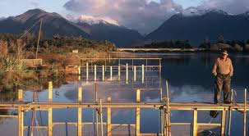
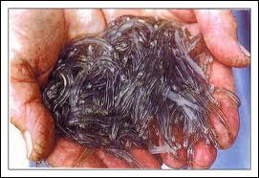
Whitebait (Inanga):
likely to disappear
by 2050 (+ many other species of native fish)

Slide 19
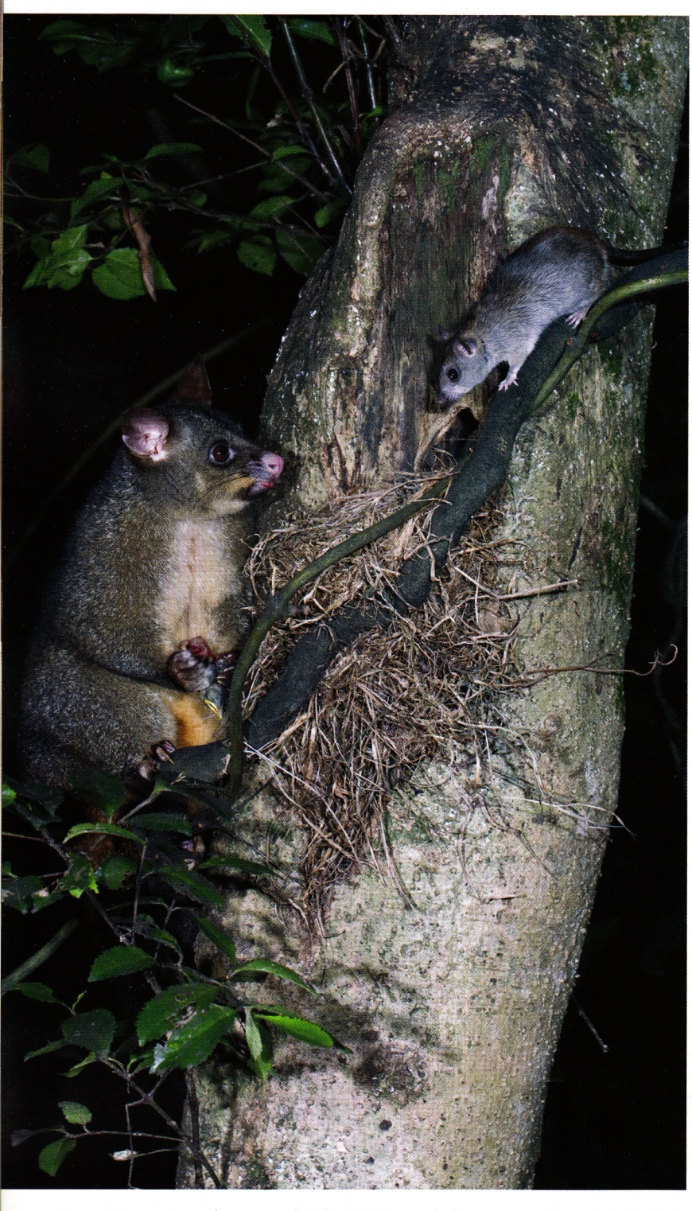
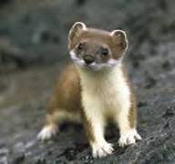
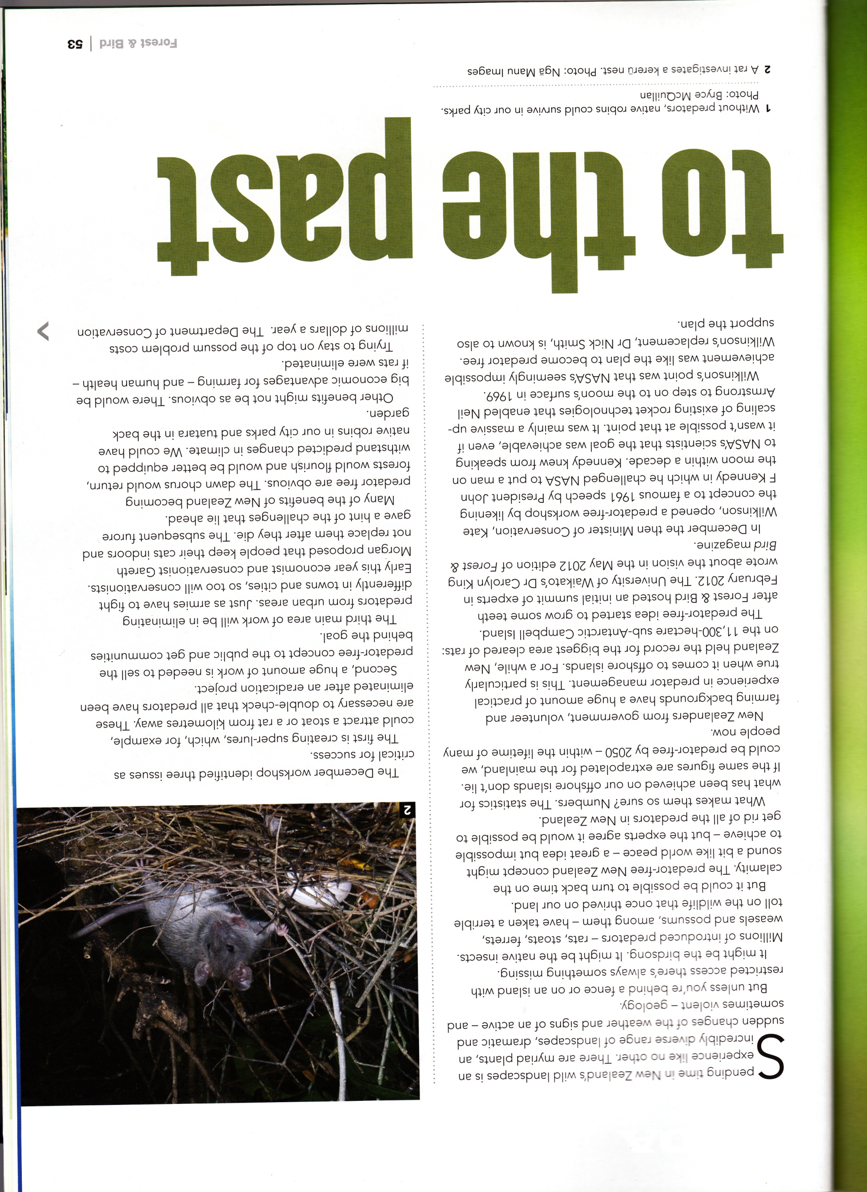
Possums, stoats, rats, weasels, and ferrets kill 26 million birds or their eggs per year.

Slide 20
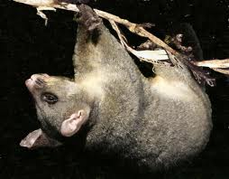
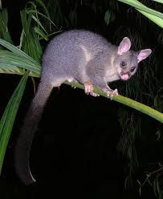
Possums
Introduced for fur in 1837.
Consume 21,000 tonnes of vegetation per night.

Slide 21
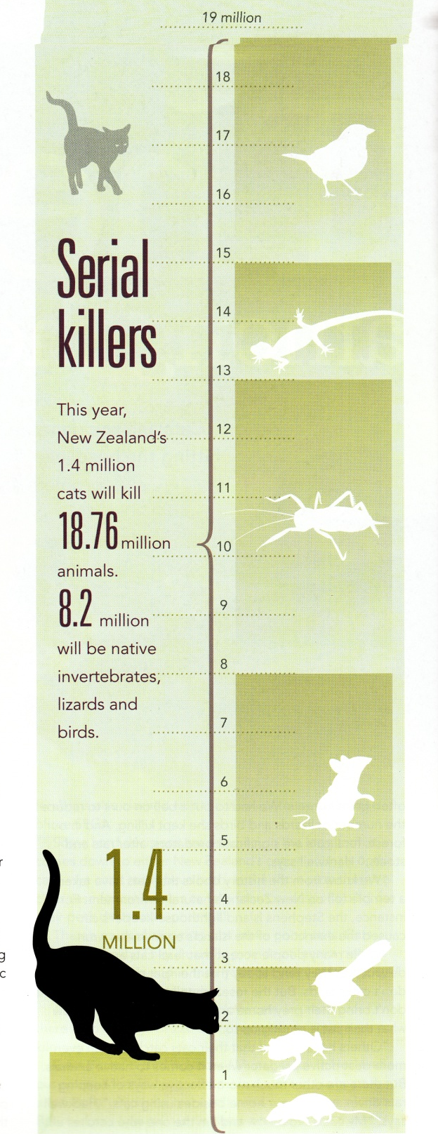
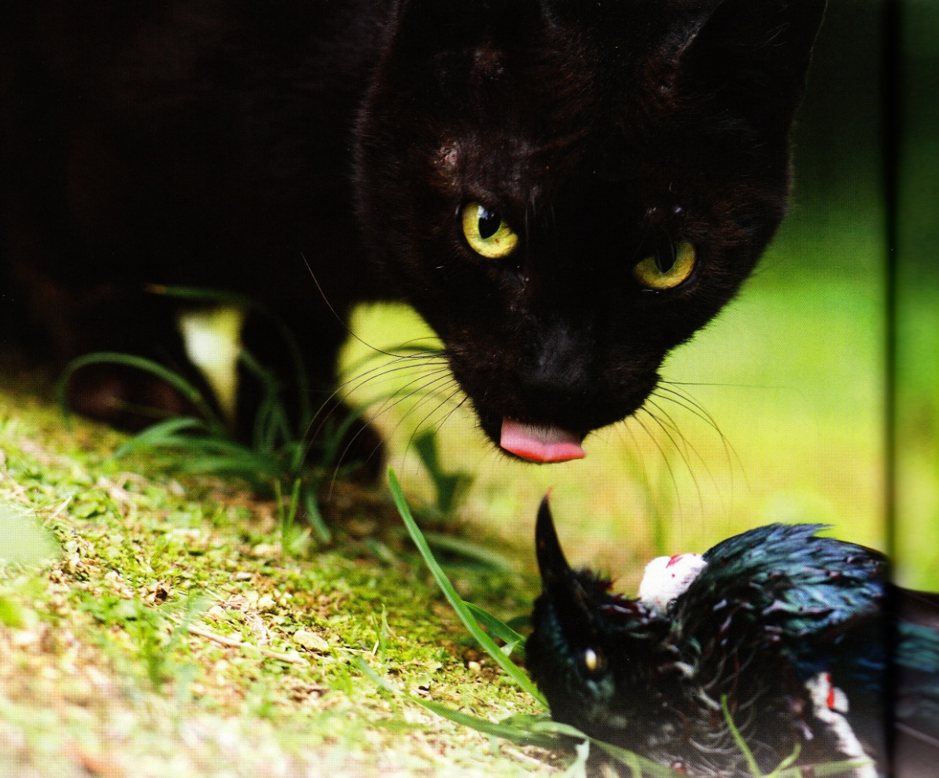
Domestic Cats

Slide 22
OFFICIAL COMPLACENCY
Scrapped moratorium on new fossil fuel generation, the bio-fuels sales obligation, car fuel efficiency standards
Cut climate research funding
Weakened the Emissions Trading Scheme and let the carbon price collapse
Failed to meet obligations under the 1997 Kyoto Protocol and refused to recommit to it in 2012
Opened up fossil fuel reserves to more
prospecting and drilling
Constructed a lot more roads
Increased tax breaks for oil companies
Repeatedly cut DoC budgets and staff

Slide 23
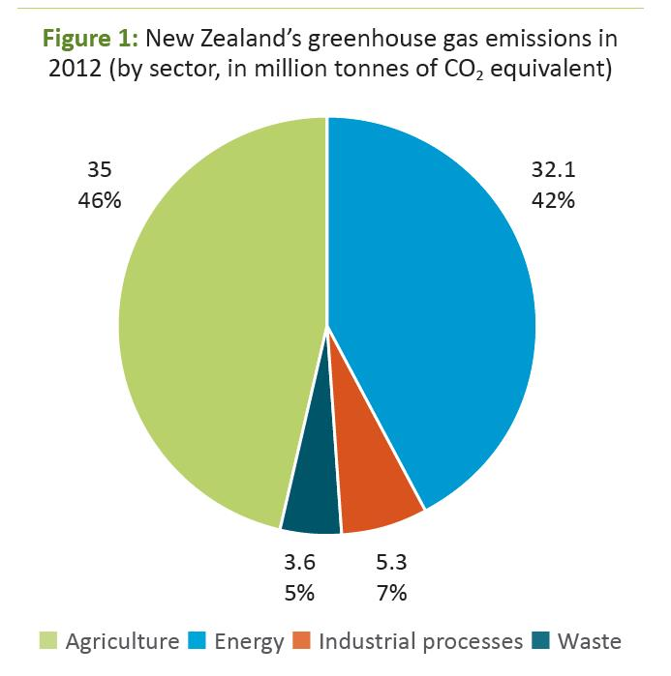
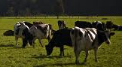
25% higher than in 1997!

Slide 24
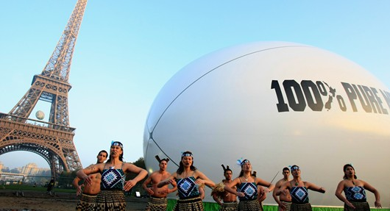


100% pure hyp?

Slide 25
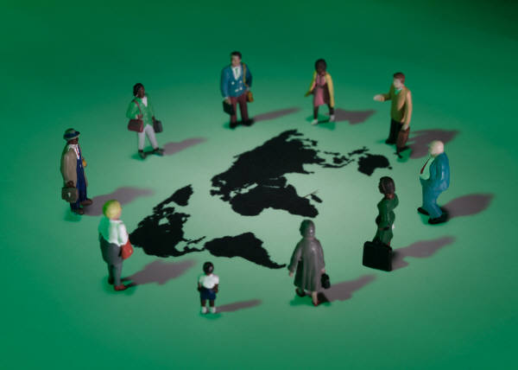
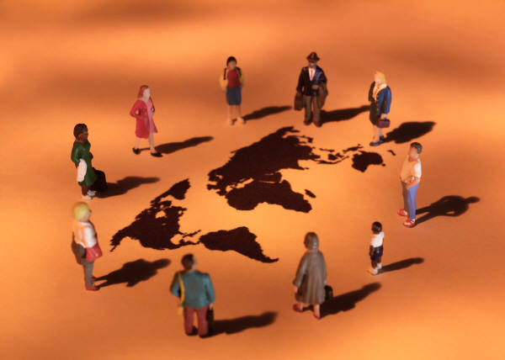
THE GLOBAL SITUATION
New Zealand is a microcosm of a worsening ecological situation around the world…

Slide 26
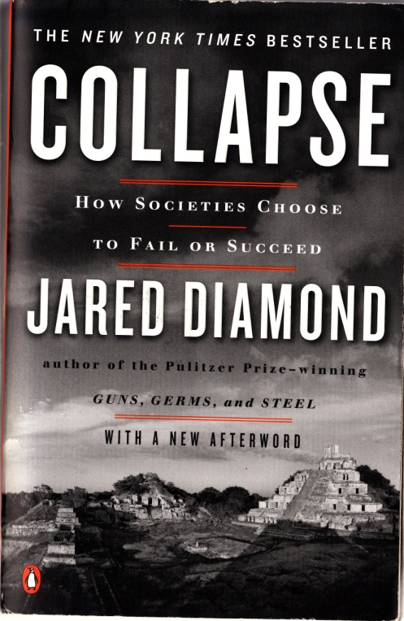
“Our world society is on a non-sustainable course, and any one of 12 problems of non-sustainability would suffice to limit our lifestyle within the next several decades. They are like time bombs with fuses of less than 50 years…”
Jared Diamond, 2005: Collapse, page 498

Slide 27
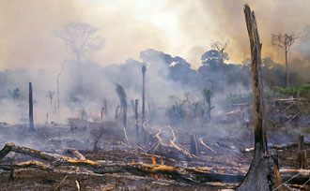
DESTRUCTION OR LOSSES OF
NATURAL RESOURCES
Natural Habitats (such as forests, wetlands, and coral reefs)
Wild Foods (especially fish and shellfish)
Biodiversity (we are already witnessing the sixth and most catastrophic global wave of extinctions)
Soil (which is being destroyed far more quickly than it is being formed)

Slide 28
CEILINGS ON NATURAL RESOURCES
Energy - coal, oil, natural gas
Freshwater - most of what is available is already being utilized.
Photosynthetic Capacity (the amount of solar energy fixed by photosynthesis)
All of these are finite and will very soon reach their limits.

Slide 29
HARMFUL THINGS
THAT WE PRODUCE OR MOVE AROUND
Toxic Chemicals - insecticides, pesticides, herbicides, detergents, plastics, etc.
Alien Species - some useful but others are hugely devastating
Atmospheric gases - which damage the protective ozone layer or absorb sunlight and thereby lead to global warming.

Slide 30
POPULATION ISSUES
Population Growth (especially the disproportionate number of children and young reproductive people)
The Impact of that Growth on the environment as so many seek a better standard of living (which the planet can't sustain)

Slide 31
“…because we are rapidly advancing along this non-sustainable course, the world’s environmental problems will get resolved in one way of another, within the lifetimes of the children and young adults alive today. The only question is whether they will become resolved in pleasant ways of our own choice, or in unpleasant ways not of our choice, such as warfare, genocide, starvation, disease epidemics, and collapses of societies…”
- Jared Diamond, 2005: Collapse, p. 498

Slide 32
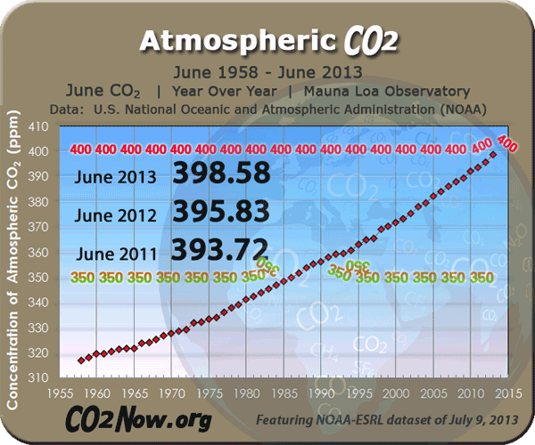
A global threshold recently exceeded…

Slide 33
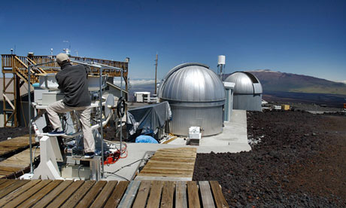
“National Geographic” website / “The Guardian” newspaper
Friday 10 May 2013
Global carbon dioxide in atmosphere passes milestone level
Hawaii's Mauna Loa observatory, where record CO2 increases are being documented.
For the first time in human history, the concentration of climate-warming carbon dioxide in the atmosphere has passed the milestone level of 400 parts per million (ppm). The last time so much greenhouse gas was in the air was several million years ago, when the Arctic was ice-free, savannah spread across the Sahara desert and sea level was up to 40 metres higher than today.
These conditions are expected to return in time, with devastating consequences for civilisation, unless emissions of CO2 from the burning of coal, gas and oil are rapidly curtailed.

Slide 34
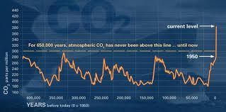
Question: When was the last time CO2 levels hit 400 ppm and humans were on earth?
Answer: Never!
Implication: We are entering uncharted territory…

Slide 35
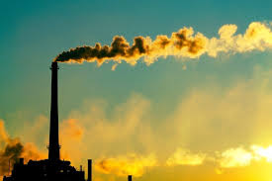


Any who doubt global warming should look at:
www.scepticalscience.com

Slide 36
"...virtually all of us are now convinced that global warming poses a clear and present danger to civilisation."
Lonnie G Thompson
(Ohio State University climatologist)
The Behaviour Analyst, 33, 2010, p.153.
“a weapon of mass destruction"
John Kerry (US Secretary of State)
ABC News, 16 February, 2014

Slide 37

UN Global Environmental Outlook Report
GEO4 (2007)
SPECIES: 2000
390 scientists
500 pages
A planet in distress…
SPECIES: 2025
SPECIES: 2050

Slide 38
“the currently observed changes to the Earth System are unprecedented in human history. Efforts to slow the rate or extent of change, including enhanced resource efficiency and mitigation measures, have resulted in moderate successes but have not succeeded in reversing adverse environmental changes. Neither the scope of these nor their speed has abated in the past five years. As human pressures on the Earth System accelerate, several critical global, regional and local thresholds are close or have already been exceeded. Once these have been passed, abrupt and possibly irreversible changes to the life-support functions of the planet are likely to occur, with significant adverse implications for human well-being.”
(UN GEO5 Report, June 2012)

Slide 39







Slide 40
“…a problem exists as real and meaningful as a sinking ship with billions of people on board. The earth is our ship, an ark for everything that lives. It is the only vessel available to carry humans through the ocean of space, and it is rapidly becoming unseaworthy.”
(Matthew Sleeth, 2006 : Serve God Save the Planet: A Call to Christian Action, page 16)

Slide 42
A CRISIS?
“Faced with a crisis that threatens our survival as a species, our entire culture is continuing to do the very thing that caused the crisis...”
(We are living in) a "jarring moment in history, when a crisis we have been studiously ignoring is hitting us in the face..."
Naomi Klein,2014:This Changes Everything, 2014,
pp.2-3
“…climate change has become an existential crisis for the human species.”
Naomi Klein, 2014: This Changes Everything, p.15

Slide 43


“…up to the present time, all of creation groans with pain, like the pain of childbirth.”
- Romans 8:22 GNB

Slide 44

The groans are getting
louder and longer…
Do you hear them?

