Slide 1
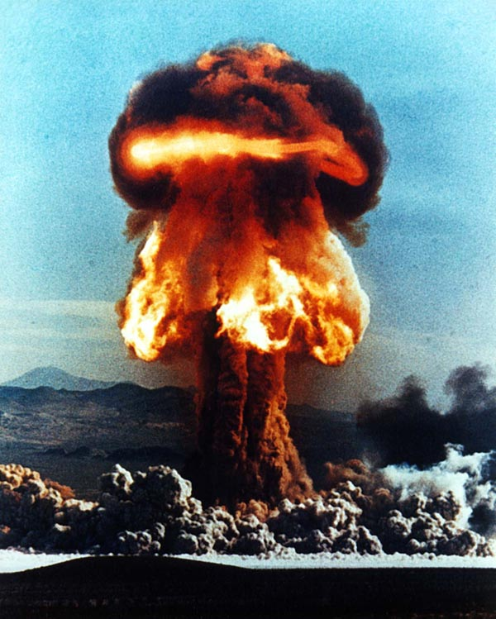
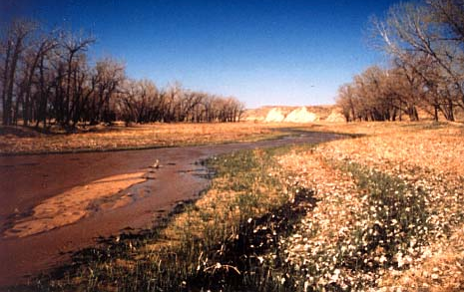
Just a little rain falling all around The grass lifts its head to the heavenly sound Just a little rain, just a little rain What have they done to the rain?
WHAT HAVE THEY DONE TO THE RAIN? THE SEARCHERS (1964)

Slide 2
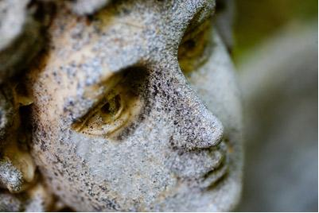
Just a little boy standing in the rain The gentle rain that falls for years And the grass is gone, the boy disappears And rain keeps falling like helpless tears And what have they done to the rain?

Slide 3
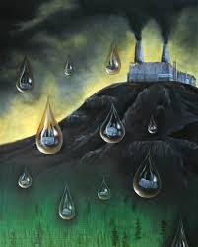
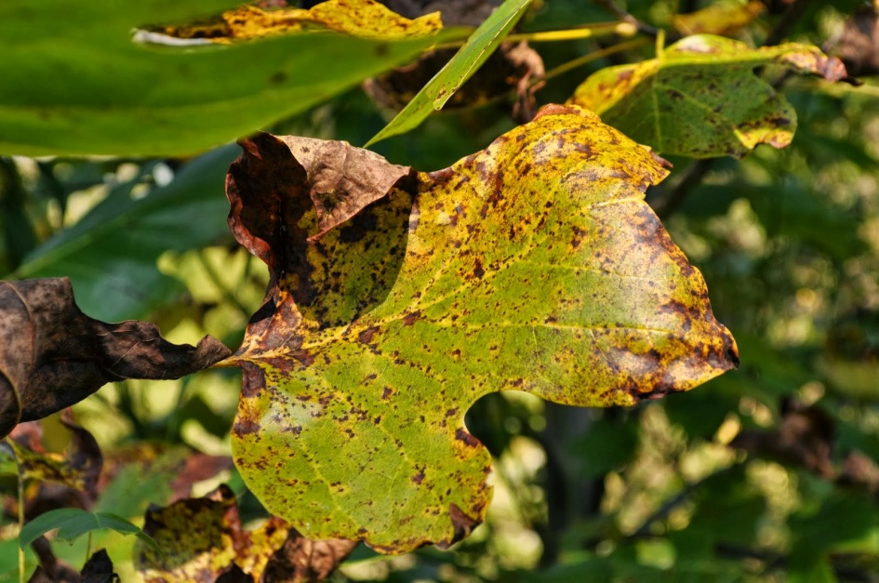
Just a little breeze out of the sky The leaves nod their head as the breeze blows by Just a little breeze with some smoke in its eye What have they done to
the rain?

Slide 4
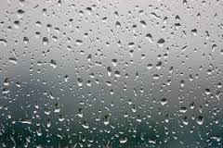
Just a little boy standing in the rain The gentle rain that falls for years And the grass is gone, the boy disappears And rain keeps falling like helpless tears And what have they done to the rain? What have they done to the rain?

